Slide 1
ECSC 325.200
Web Server Administration
Spring 2025 – Week 3-1 – January 28th, 2025
Infrastructure components

Slide 2

Objectives
TCP/IP Review
OSI Layers Review
Packets and Headers
IP & Subnetting
Classful vs. Classless
Some reviews
DNS Intro
Linux Basics
Operating System Installs
First Configs

Slide 3

Weekly Info
"Darkness cannot drive out darkness; only light can do that. Hate cannot drive out hate; only love can do that." - Martin Luther King Jr
Scientists are claiming they found the origins of the dinosaurs
  “ Equatorial Gondwana”
    Equator region of supercontinent that broke apart from Pangea?
    Formed some 500 million years ago
Attendance
Good of the Class
Assignment 3 available

Slide 4

Recap and Review
The next few weeks…
  Users, permissions, installations, DNS, & stuff
  Midterm – February 27th, 2025
Review of topics from last class
Corrections, updates, etc.
  Office hours from 4:15pm – 5:00pm on Tuesday’s and Thursday’s
Review of previous assignments
Questions from previous classes
Assignments due?
Etc…

Slide 5
Documentation Expectations
Documentation expectations examples:
  Edit the network configuration file /etc/sysconfig/network-scripts/ifcfg-bond0
    Updated the following information in the network configuration file:
      IPADDR=147.64.243.115
      HOSTMASK=255.255.254.0
      DNS1=147.64.242.100
      DNS2=147.64.242.101
  Restarted the network services to apply configuration changes
      systemctl restart network
  Added entry to /etc/fstab file for persistent mount
    147.64.243.115:/data /data nfs bg,rw,sync,hard,intr 0 0
  Updated and rebooted the system
      dnf –y update; reboot

Slide 6
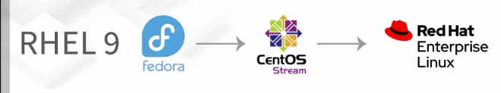
Assignment 1 Review
Part A – 10 Points
Browse through the popular Linux distributions at DistroWatch.com. Choose three Linux distributions, and describe how they are different from other distro’s. What makes each one unique? Why would I use it?
Red Hat Enterprise Linux/Fedora/CentOS
Ubuntu
Kali Linux

Slide 7
Assignment 1 Review
Part B – 10 Points
Put together a list of network hardware you think you would need to create a small business network. You will need to connect up to 16 wired desktop PC’s, 8 wired servers, 4 other wired devices, a wireless access point, and a Network Accessible Storage device. You will also need Internet access; describe the type of internet connectivity and the hardware involved. All that is required is a simple list of hardware devices.
Two 16+ port network switches for desktops, Wi-Fi, and other wired devices (managed switches)
Two 10+ port switches for servers and NAS (redundancy)
One router to connect to the internet/WAN
Network Cable (cat5e/cat6)
Cable modem, DSL modem, Fiber Optic Network Terminal (ONT) (depends on WAN connection)
Internet router/firewall

Slide 8
Assignment 1 Review
Part C:
1. Define the Internet. - A worldwide network of networks.
2. Define the Web. - An open information space where documents and other web resources can be accessed via the Internet.
3. Is e-mail part of the Web or Internet? - Internet
4. What is a backbone? - A principal data route between large, strategically interconnected networks and core routers on the Internet.
5. What does TCP/IP stand for? - Transmission Control Protocol / Internet Protocol
6. What does HTTP stand for? - Hyper Text Transfer Protocol
7. What is HTTPS, why is it used, and how is it different from S-HTTP? - HTTPS is secure encrypted HTTP traffic, used for keeping communications private. S-HTTP is another form of HTTP encryption, but only a portion of the data is encrypted

Slide 9
Assignment 1 Review
Part C:
8. Explain peering arraignments – A mutually beneficial exchange of network traffic between peers.
9. A web server can also be an FTP server and an e-mail server - True
10. List two programming languages available for Web servers – PHP, Java, .NET, etc…
11. List 5 different types of server administrators – Database, middleware, OS, network, e-mail, web, etc…
12. What is DNS and what does it do? - Provides a system to translate IP addresses to hostnames, and maintain hierarchical ownership/administration.
13. What are four tasks that are common to all system administrators? – Backups, patching, maintenance, configurations
14. What protocol is used to send e-mail? – SMTP – Simple Mail Transport Protocol

Slide 10
Assignment 1 Review
Part C:
15. What protocol is used to transfer files? – FTP – File Transfer Protocol
16. What protocol provides an addressing scheme - Internet Protocol (IP)
17. Define UDP and explain when it is used instead of TCP. - UDP is the User Datagram Protocol, and is a connectionless protocol. UDP uses less network resources than TCP, and is typically used for live audio/video (skype/telephone), gaming, and VPN's.
18. Explain what a router does in a network. - Routes/Forwards data packets between computer networks.
19. What is bandwidth? - The rate of available or consumed capacity.
20. How do you connect to the Internet outside of school, and what hardware is involved? - Linux PC router/switch, cable modem

Slide 11
Routing
Static Routing
  Specific, hard-coded route to a destination network
    All Internet traffic goes out the internet interface
    Traffic for Hamilton building goes out specific interface
Dynamic Routing
  Used for tracking large numbers of subnets
  Large network installations
  Internet installations
  Multiple protocols exist for
  dynamic routing rules
Transferring packets between networks
Routing Tables
  Indicate a current list of routes
  Commands:
    route on Linux
    route print on Windows

Slide 12
Network Commands and Information
ifconfig
  Display and configure network interfaces on a system
ip
  Display and configure network interfaces on a system
nmcli
  Display and configure network interfaces on a RHEL7/CentOS7 system
route
  Display and configure network routes
IP Aliasing
  Virtual (Private) IP – VIP
  Allow for multiple IP addresses on a single network interface
Run-time and boot-time configurations!

Slide 13
Network Commands and Information
netstat
  Display and configure network connections on a system
hostname
  Display and configure a system hostname
  Fully qualified hostname – FQDN – hostname and domain name
    ecsc325-101.cs.edinboro.edu
  Short hostname – just the hostname, no domain name
    ecsc325-101
Run-time and boot-time configurations!

Slide 14
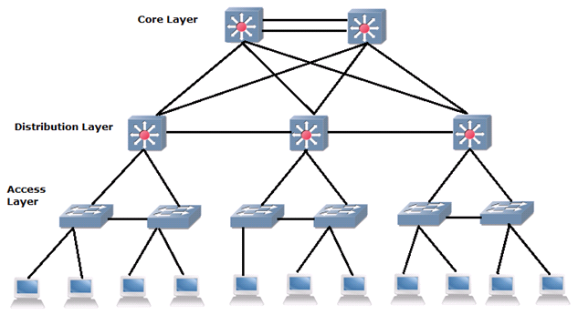
Networking
Networking is the foundation of a sites infrastructure
  A bad network creates perception of bad servers
Keep it simple – clean architecture
  Simple to understand, easy to diagram
  Easier to troubleshoot and support
Limit supported protocols
  Especially across WAN connections
Implement redundancy where appropriate
  WAN links or data center connections

Slide 15
Networking
Test your connections!
Flat topology (yuck)
  Network of all layer 2 devices (switches)
Intermediate Distribution Frame (IDF)
  Wiring closet
  Keep secure!
  Battery backed power
  Patch panels
Main Distribution Frame (MDF)
  Connects IDF’s
  May be inside data center
Network Core
  Connections between distribution layer

Slide 16
Networking
Documentation?!
Demarcation Points
  The boundary between your equipment
  and the providers equipment
Documentation
  Patch panel labeling
  Cable labeling
  Wall jack labeling
  Device naming conventions
Keep routing to routers
  Hosts can support routing, don’t do it
  Rogue routing updates can affect
  misconfigured hosts
  Performance impact

Slide 17
Networking
Too many eggs…
Use dedicated hardware where appropriate!
  Separate functionality
    Switches
    Routers
    Wi-Fi access
    Firewalls
    Isolates potential issues
  Dedicated hardware
    Performs one task really well
Overlay networks
  Logical topology on top of a
  physical topology
  Virtual LANs

Slide 18
Networking
Minimize unique vendors
  Keep it simple…
Use standard based protocols
  Keep it simple…
Monitor your network
  Repair as necessary
  Maintain historical data to show trends
Redundancy where appropriate
  Cost/benefit analysis
Minimal administrative domains
  One or few bodies maintains the network
  Consistent design, maintenance, etc.
Uptime!
Notes:
99.999% = 5 Nines = 5.26 minutes/year
99.99% = 4 Nines = 26.28 minutes/year
99.9% = 3 Nines = 8.76 hours/year
99% = 2 Nines = 3.65 days/year
90% = 1 Nine = 36.5 days/year

Slide 19
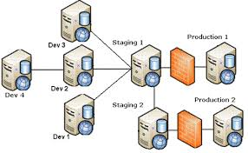
Deployment Environments
Development
  Location for development and creation of a program or component
Test
  Deployment and functionality is tested to work correctly
  More similar to production environment
Acceptance/Performance/Staging
  Performance and regression testing
  Most similar to production environment
Production
  The actual systems visible to customers

Slide 20
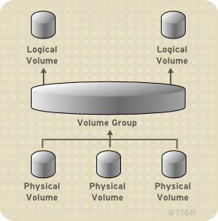
Logical Volume Management
Disks (Physical Volumes)
  Physical devices storing data
  Can be RAID devices
  Can be virtual disks presented to an OS as a physical device!
    LUNs in a SAN system, virtual disks in a virtual guest environment
Partitions
  Separate regions of disks
Volume groups
  Groups of disks or partitions
Notes:
Typically you will see a single disk (/dev/sda or similar), two partitions (/boot and a vol group), one or more logical volumes (separate /home or /var), on an ext3/4 or xfs file system.

Slide 21
Logical Volume Management
Logical volumes
  Individual volumes within a volume group
File systems
  Specifies how data is stored and organized
Mount points
  Where is this storage mapped to within the filesystem
  /, /var, /home, /opt, /mnt
df -h command
  Show disk space usage in a human-readable format
/etc/fstab file
  Specified boot time filesystem mounting configuration
Notes:
Typically you will see a single disk (/dev/sda or similar), two partitions (/boot and a vol group), one or more logical volumes (separate /home or /var), on an ext3/4 or xfs file system.

Slide 22

Data Centers
Considerations
  Heating and cooling, humidity control, ventilation
  Fire suppression
  UPS Battery backup and generators
  Overhead cable tray runs
  Under floor power cable runs
  Hot and cold aisles
  Physical location
  Quality equipment
  Ability to withstand natural disasters
    Lightning strikes
    Earthquakes
    Maybe the basement isn’t the best place for your data center,
    if the basement is prone to flooding…
Proper Airflow!

Slide 23
Data Centers
Considerations
  Rack-mount environment
  Redundant service providers
    Multiple separate power feeds
    Multiple separate network connections
    Power bypass switches
  Redundant everything else
  Wide doors and ramps
  Panic buttons, cancel switches, other switches
    Cover your important switches!
  Backup lighting
  Co-Location facilities
  Bunker-style facilities?!
  Lightning protection
Redundant Everything!

Slide 24
Data Centers
Considerations
  Row and aisle locations
  Access control mechanisms
    Magnetic card, RFID, biometric, pin, key
    Secure access
    No windows or direct outside entry
    Disability or special needs…
  Egress
    Self locking self closing doors that can be easily opened from inside
  Power conditioning
    Utility power is dirty
  Various sensors
    Temperature, humidity, airflow, power, etc.
  Power distribution units
    Network addressable “smart” sensors
Cable Labeling!

Slide 25
Data Centers
Create and follow standards!
Considerations
  Crash cart
    Wired and wireless access
    Console adapters
    Telephones
    Monitor, keyboard, mouse
    KVM Switch
  Work area
    Performing maintenance on hardware
    Area parts can be kept securely
  Tools and supplies
    Flashlights!!!
    Cables and accessories
    External USB DVD drive?

Slide 26
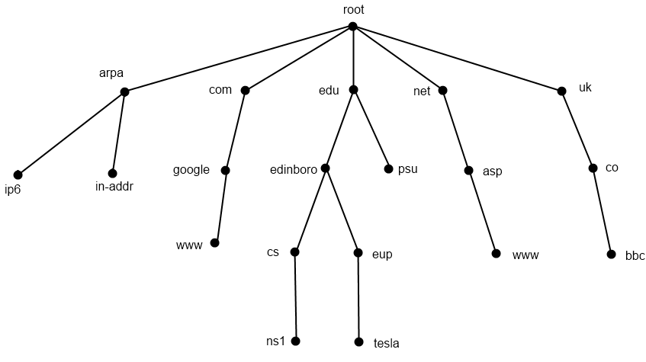
DNS Hierarchical View
13 root nameserver maintainers!
Notes:
13 Root nameservers maintainers, such as verisign, nasa & U of Maryland
259 total root servers (as of 11/30/11)
273 TLD’s
63 characters per level
127 levels max
253 characters per FQDN

Slide 27
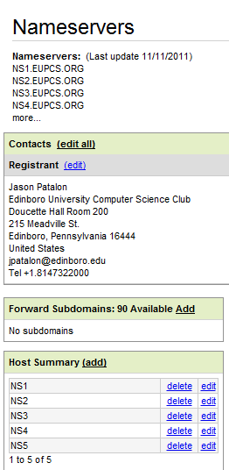
DNS Glue Records
IP addresses of nameservers at parent
A and AAAA
Configured at parent or registrar
  GoDaddy, NameCheap, etc.
  Edinboro.edu for a subdomain
    cs.edinboro.edu

Slide 28
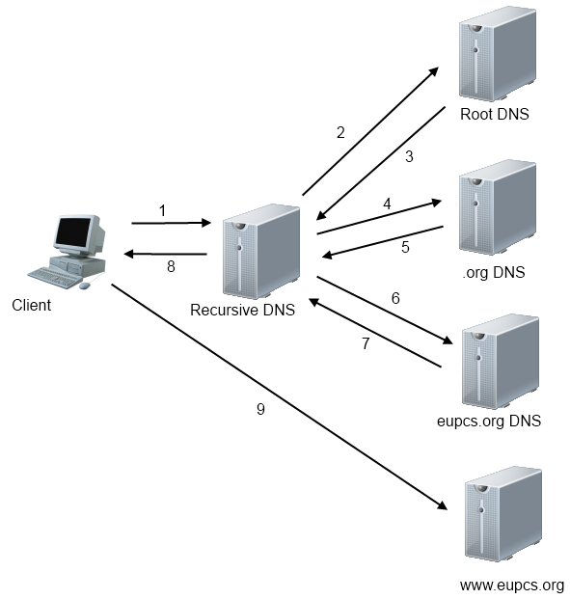
DNS Transaction

Slide 29
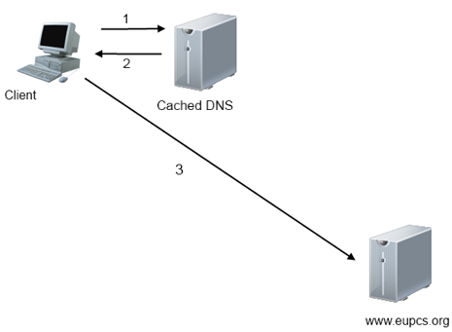
Cached DNS Transaction

Slide 30

DNS Transaction
DNS Record: www.eupcs.org
dig ns
  Response: a.root-servers.net
dig ns biz @a.root-servers.net
  Response: a.gtld.biz
dig ns megastuff.biz @a.gtld.biz
  Response: ns-cloud-c1.googledomains.com
dig a 101.megastuff.biz @ns-cloud-c1.googledomains.com
  Response: 147.64.243.110
Root Hints!
Notes:
Root hints tell a name server the initial root DNS server IP addresses. Root hints are maintained locally on a recursive DNS server.

Slide 31
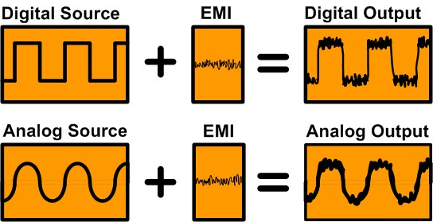
Digital vs. Analog Signals
Analog
  Values anywhere between 0-1
Digital
  Values either 0 or 1
Analog signals are often digitized for storage
  Music
Notes:
Digital is either 1 or 0; Analog is any value between 1 and 0.

Slide 32
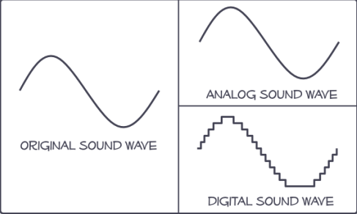
Digital vs. Analog Signals
Sound waves digitized
  Samples per second
    CD: 44,000 samples per second
  Signal doesn’t degrade
    As long as numbers can be read, output will be exactly the same
  Easier to compress
    Groups of numbers can be compressed by finding patterns in the sequences
Notes:
Analog may sound better, but digital can easily be stored, replicated, transported, etc.

Slide 33
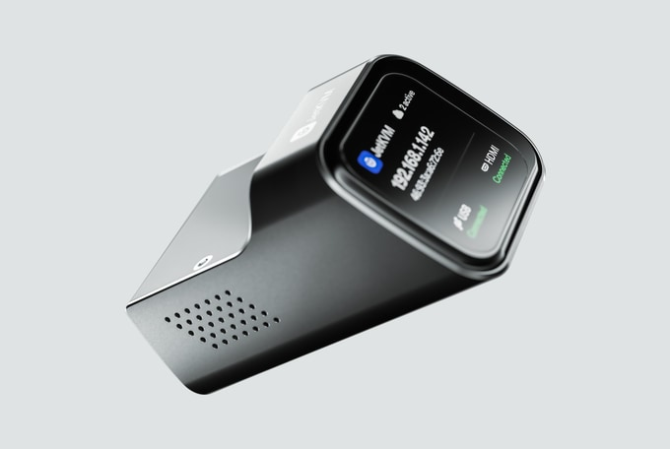
Technology and Terms
In-Band Connections
  Connections that happen over traditional network connections
  HTTP, SSH, Telnet, FTP, RDP, VNC
Out-of-Band Connections (OOB)
  IPMI: Intelligent Platform Management Interface
    A set of interface specifications that provides management and monitoring capabilities independently of the host system
  Connections over a separate network connection
  Typically separate interface and network
  Also often called Lights Out Management (LOM)
  Allows for remote console access
    BIOS access, bootup and shutdown watching
    Hardware monitoring (fans, power, temperature, etc.)
  Typically VNC or Java
    Yeah sure, they can be other things too…
JetKVM
Notes:
HP iLO
Dell RAC
Others…

Slide 34

Technology and Terms
SSH – Secure Shell
  Creates an encrypted terminal connection to a server shell
  Allows for other types of communication to be tunneled through the SSH connection
    Tunneling insecure information through a secure tunnel creates a secure connection!
  In Windows, you can use the program Putty to SSH in to a server
  In Linux/MacOS, you can run the SSH command directly from the command line
VNC and RDP
  Allow for a connection to a server GUI
  Can be used for in-band and out-of-band connections
  RDP (Remote Desktop Protocol) is common in Windows environments
  VNC is common most other environments
    VNC connections are typically not encrypted,
    and tunneled through encrypted SSH connections.
Notes:
SSH is my favorite application protocol.

Slide 35
Linux Directory Structure
Root – Top level directory
  Represented by a forward slash /
  Similar to C:\ on Windows
/bin – User applications (binaries)
/sbin – System applications
/etc – Config files
/dev – Device files
  Virtual file systems!
/proc – Process Information
/var – Variable files
/usr – User programs
/opt – Additional optional programs
/home – Home directories
/root – Root user home directory
/boot – Boot loader files
/lib – System library files
/mnt – Mount directory
/tmp – Temporary files

Slide 36
Linux Commands
su – switch user command – allows user to impersonate another
  Most commonly used to impersonate root
sudo – switch user do (super user do) – run a command as another user
vi – visual editor – command driven text based editor
  Press i to switch to insert mode, esc to return to command mode
  Type command :wq! to save and close the file (write and quit)
  Most popular Unix/Linux editor
nano – simple text editor
  Caret symbol represents control button (^X = crtl+x)
gedit – graphical editor similar to Windows Notepad
joe – another simple editor

Slide 37
Linux Commands
cd – change directory
  Ex: cd /home/jpatalon
echo – return a string or value
  Ex: echo ‘Hello World!’
| (pipe) – Transfer output from one program to another program
> (greater than sign) – Write program output to a file, overwriting any data
>> (2 greater than signs) – Append output to a file
wget – download a file from the internet
cat – display the contents of a file
hostname – display information about the host name

Slide 38
Linux Commands
mkdir – Make a directory
  Ex: mkdir /home/jpatalon/folder
useradd – add a new user
  Ex: useradd jpatalon
passwd – change a password
  Ex: passwd – Changes the password of the current user
  Ex: passwd jpatalon – Changes the password of user jpatalon
dnf – Manage installed packages and software
  dnf search <package>
  dnf install <package>
  dnf update

Slide 39

Manual Pages
Manual pages show detailed information about a command
Can be accessed with the man command
  Ex: man which – displays manual pages for the which command
Many programs will also give detailed command usage with the --help command
  Ex: which --help will give additional command syntax and information
Red Team Field Manual
  An actual manual to take in the field!

Slide 40
Command Line Interface (CLI)
Background a job (&)
  Append an ampersand to the end of the command
    Ex: top &
  Bring the job into the foreground
    Ex: fg <job>
Environment Variables
  Various variables in your shell
    echo $SHELL
    var=asdf
    echo $var
  Variable can be numbers, words, letters, arrays, command output…
    var=$(cat /etc/fstab)
    var=`cat /etc/fstab`
      Backticks ^
Everything is case sensitive!

Slide 41
Command Line Interface (CLI)
Linux Shell
  Environment provided for a user; dictates commands and variable structures…
  BASH Shell – Bourne Again SHell
  C Shell
  KSH – Korn Shell
Tab completion (BASH)
  Type the first few letters, press tab, system will attempt to auto-complete
String multiple commands together
  Cat a file, grep for specific words, count the number of words
    Ex: cat /tmp/filename | grep words | wc
Man
  Run the man command to access manual pages!
    Ex: man which

Slide 42
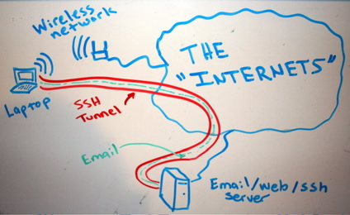
SSH Tunnel
Open an encrypted tunnel to our server
Forward a port on our local machine to a port on the remote machine
Forwarded ports can connect to the localhost interface of our server
  Prevents opening ports on network interfaces/firewall!
Proxy data through our server
  SOCKS Proxy!
Example
  ssh -L 5900:127.0.0.1:5900
  -L 5901:127.0.0.1:5901
  -L 44444:10.11.187.5:3389
  -D 8080 -2 -C <servername> -p <port>

Slide 43
Physical Machine Installation
Plug in and power on machine
Press F12 during bootup
  Different hardware may use a different key to enter bios
Notice BIOS Menu
  BIOS will let you configure many settings,
  such as boot order or hardware settings
Choose "ATAPI CD0“
  Boot from CD
  Different hardware may have a different specific name
Optionally, you can enter the BIOS, and configure the CD/DVD-ROM as the first boot device
  BIOS can be password protected
We have VM’s that are already built!

Slide 44
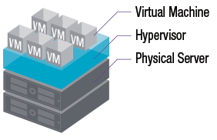
Virtual Machine Installation
Configure VM to boot from iso
  Each hypervisor is configured in a different fashion
  My personal environment uses QEMU/KVM
    virsh destroy ecsc325
      Pull out power!
    virsh edit ecsc325
      Boot device
      Device cdrom
    virsh start ecsc325
Boot VM
  Connect to OOB console
    QEMU creates a console connection on a localhost port
    SSH tunnel forwarding that port
    VNC connection to that port via localhost tunnel
      Encrypted console connection from anywhere in the world!
Our class VM’s run on KVM

Slide 45
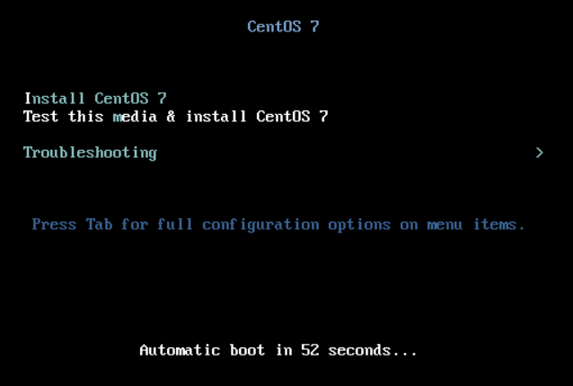
Install
Install CentOS 7 Media
Optionally test media
Troubleshooting Menu
We are using CentOS 9!

Slide 46
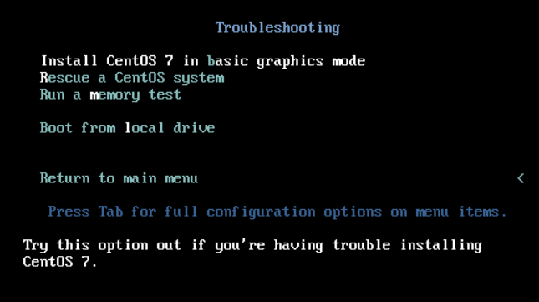
Install
Install CentOS 7 Media
Optionally test media
Troubleshooting Menu
  Basic Graphic Mode Install
  Rescue Mode!
  Memory Test
  Local Drive Boot
  Press Tab for more options

Slide 47
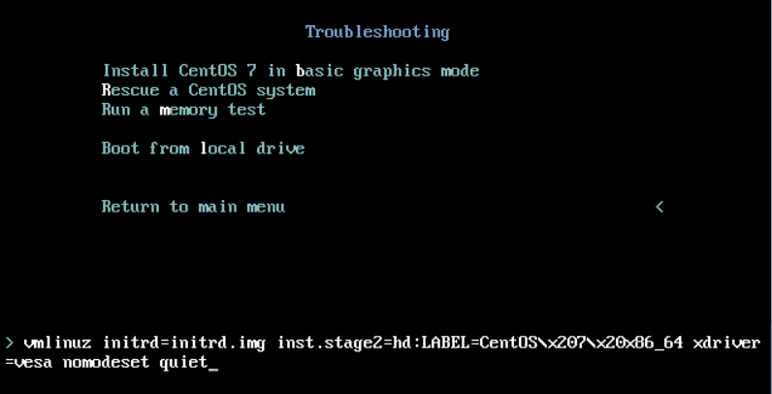
Install
Install CentOS 7 Media
Optionally test media
Troubleshooting Menu
  Basic Graphic Mode Install
  Rescue Mode!
  Memory Test
  Local Drive Boot
  Press Tab for more options
    Kernel boot options
    Display options
    Advanced options
    Add separate word
    single for single user mode

Slide 48
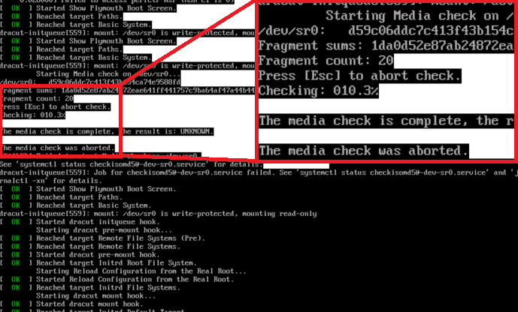
Install
Optionally skip media check
  If you have issues with
  incomplete or inoperable
  installations, validate your
  installation media
  Validate downloaded image
  hash file (md5sum)

Slide 49
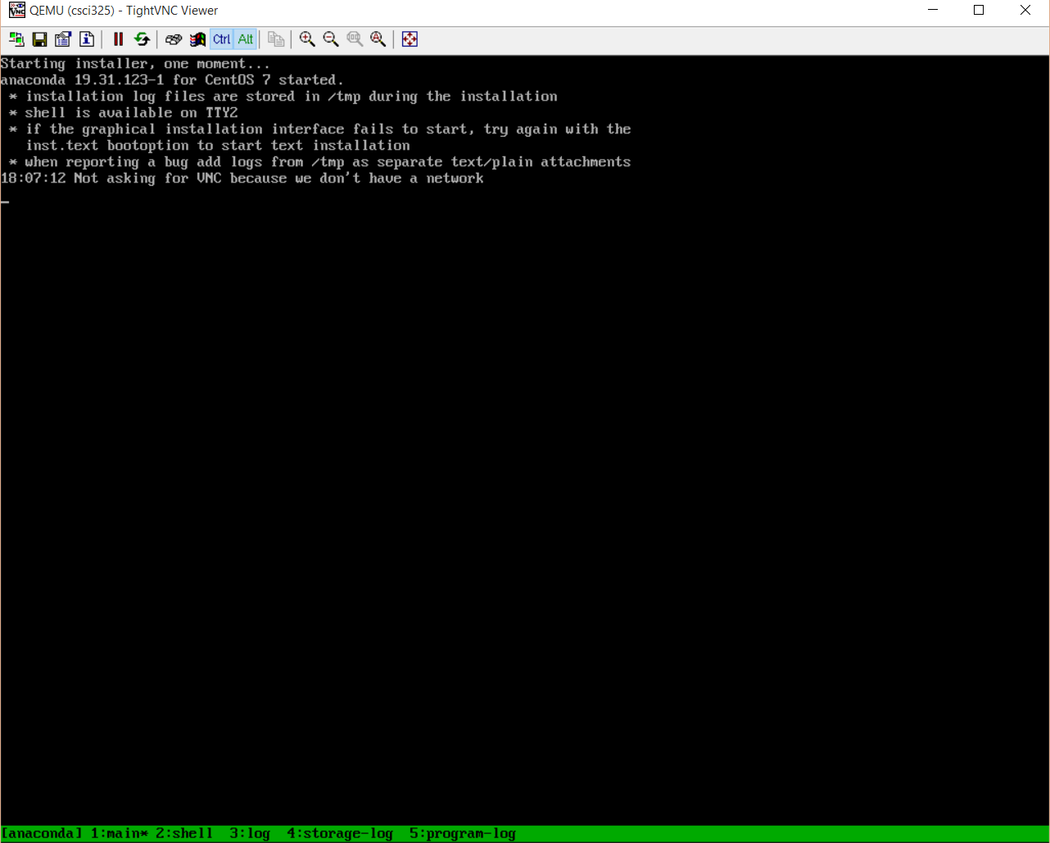
Install
Anaconda Boot Installer
  Switch between screens during install
    CRTL+ALT+(F1-F6)
    Main install F1
    Shell on F2
    Logs on F3-F5
    GUI on F6

Slide 50
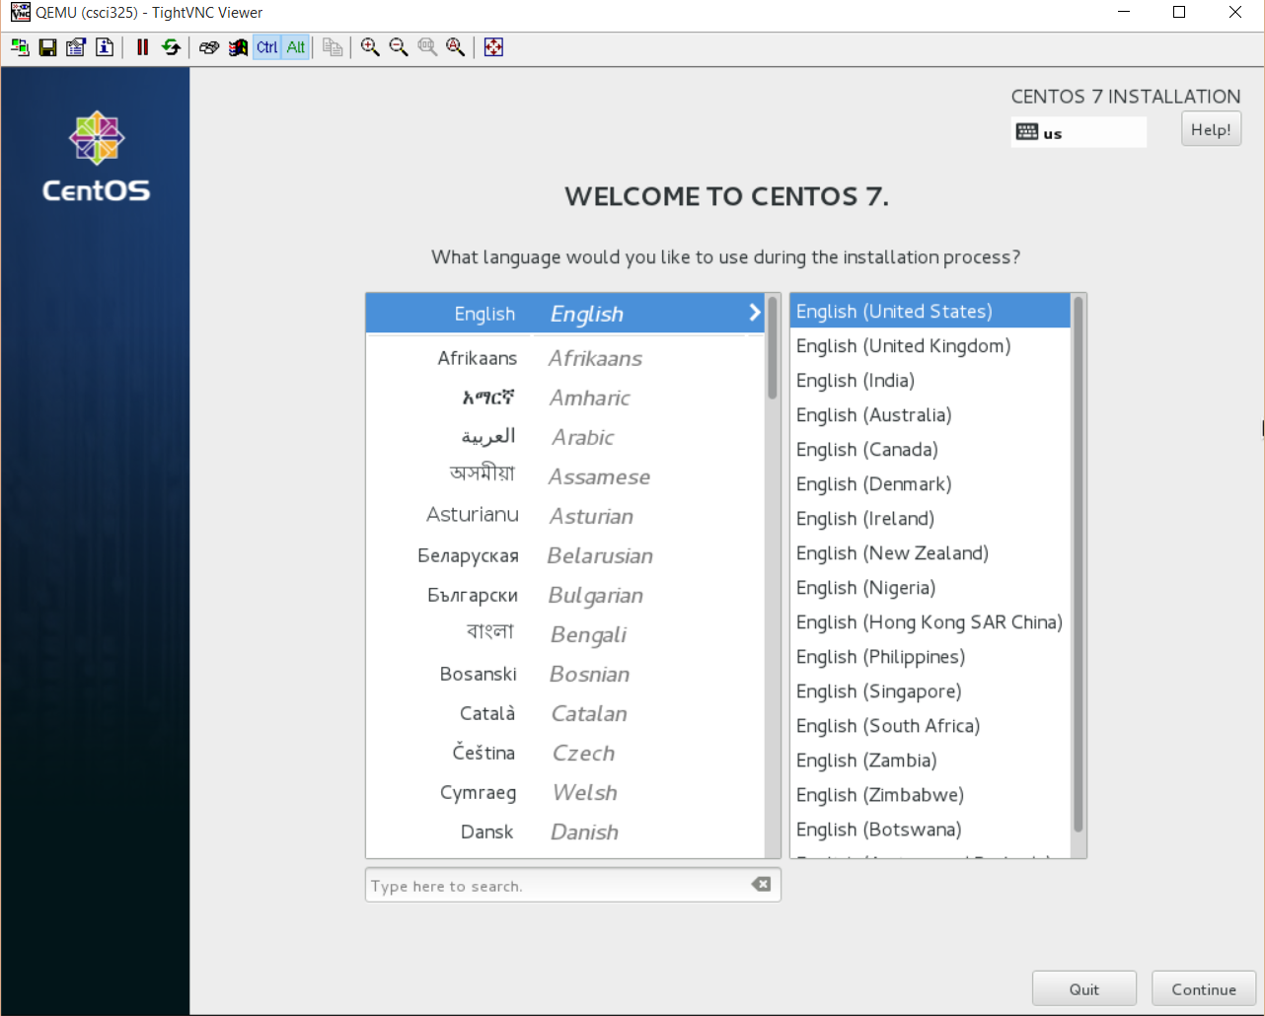
Install
Select desired language and press Continue

Slide 51
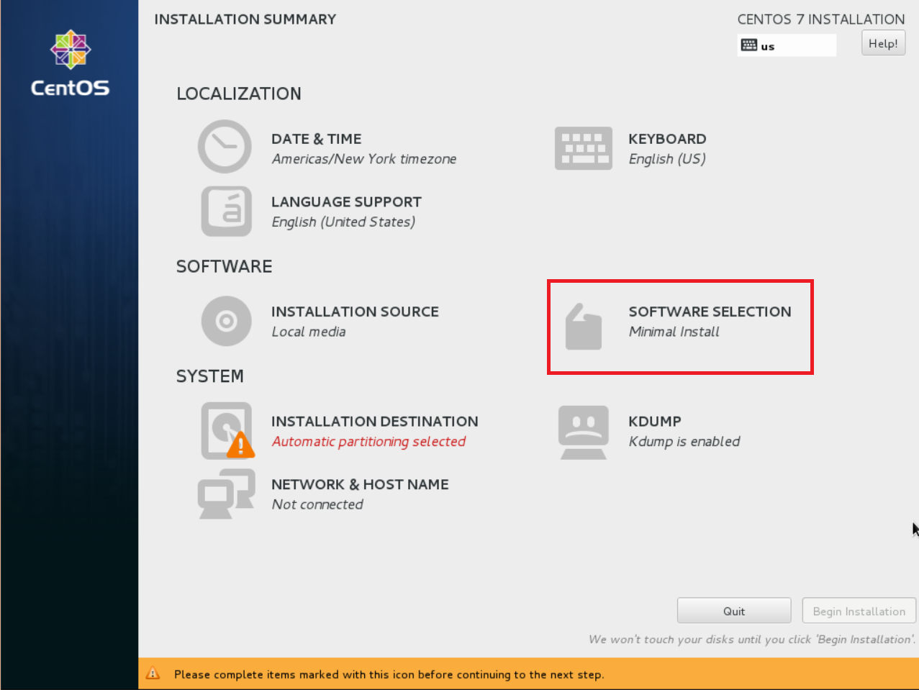
Install
Start by changing our desired software install

Slide 52
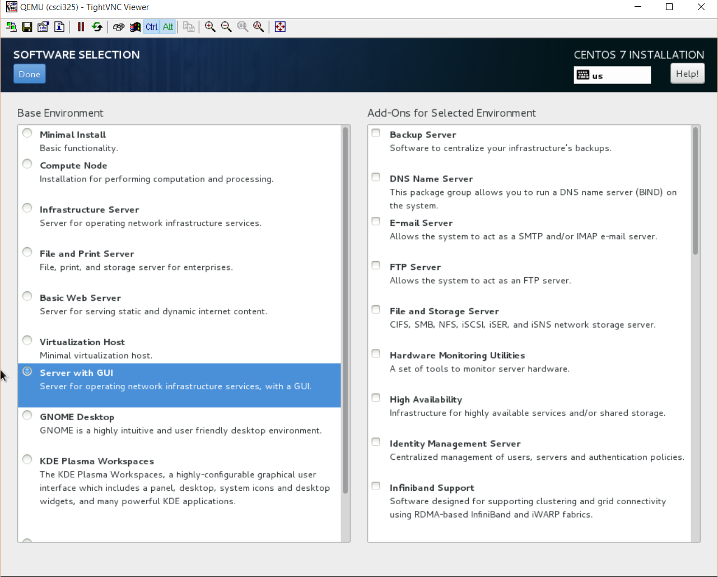
Install
Typically I will use Minimal Install, Infrastructure Server, or a custom install
Our VM’s are installed as a Minimal Install

Slide 53
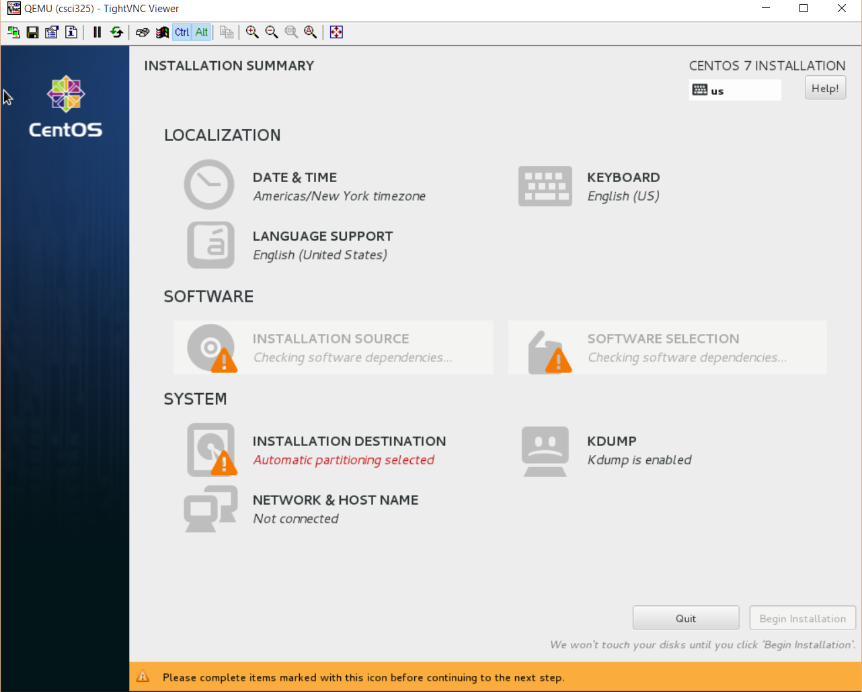
Install
Software selection and installation source is verified for changes

Slide 54
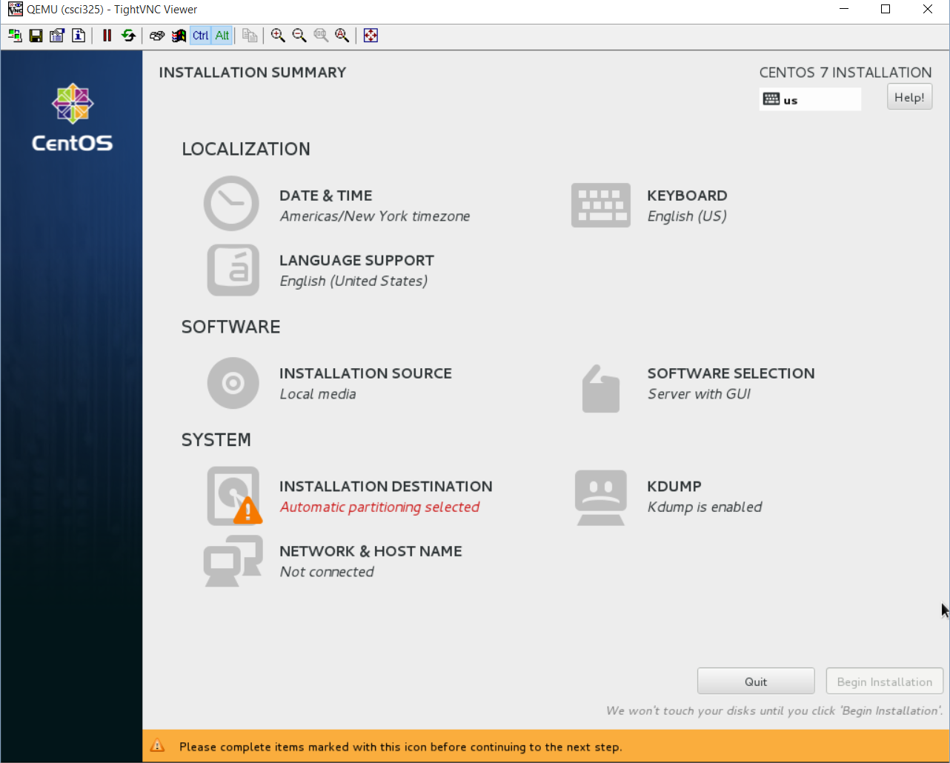
Install
Select Installation Destination to configure the storage location where we will install our operating system

Slide 55
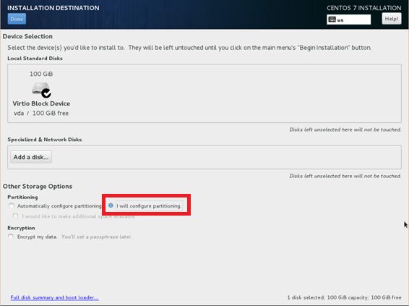
Install
Make sure we have a check on our desired Local Standard Disks
Choose the option to allow you to configure partitioning

Slide 56
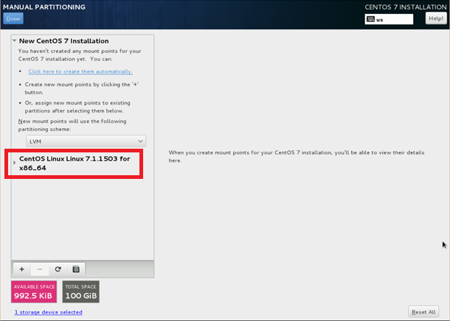
Install
If there are any existing installations, delete them

Slide 57
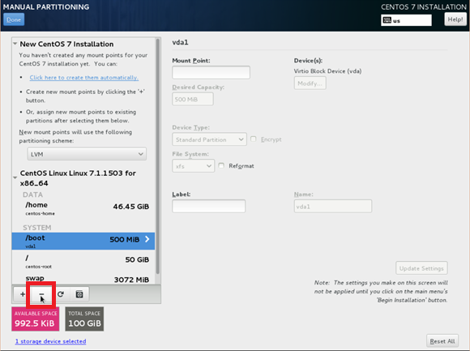
Install
If there are any existing installations, delete them
  Select installation to delete
  Click minus button

Slide 58
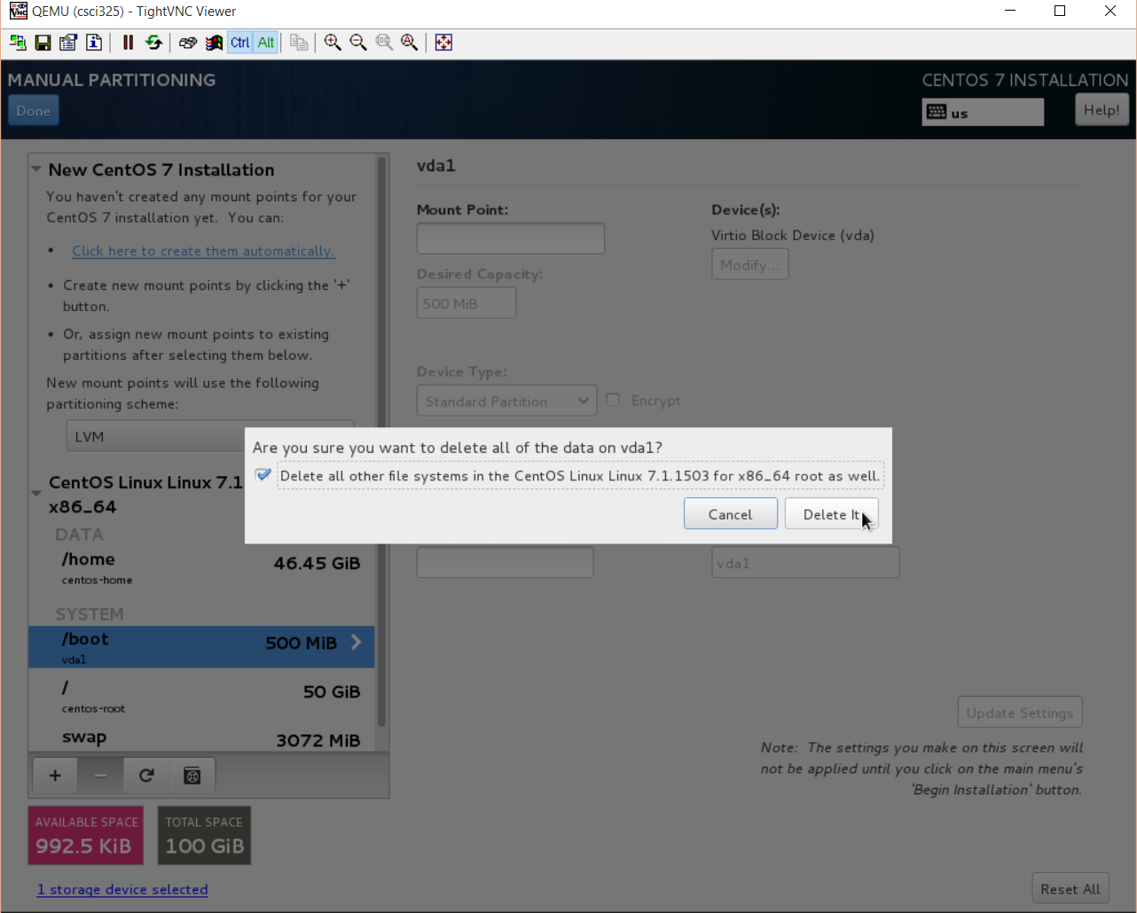
Install
If there are any existing installations, delete them
  Select installation to delete
  Click minus button
  Check the box to delete all other file systems that may be part of that installation

Slide 59
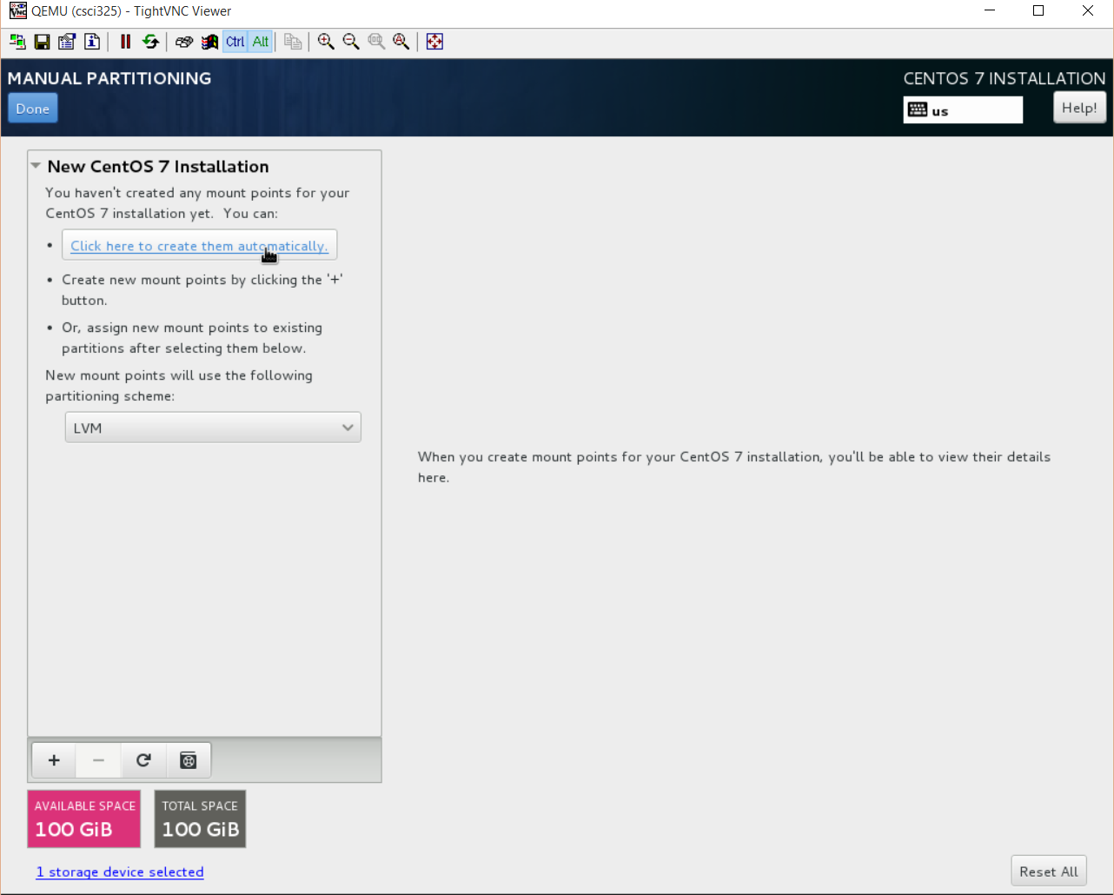
Install
Create new install partitions automatically

Slide 60
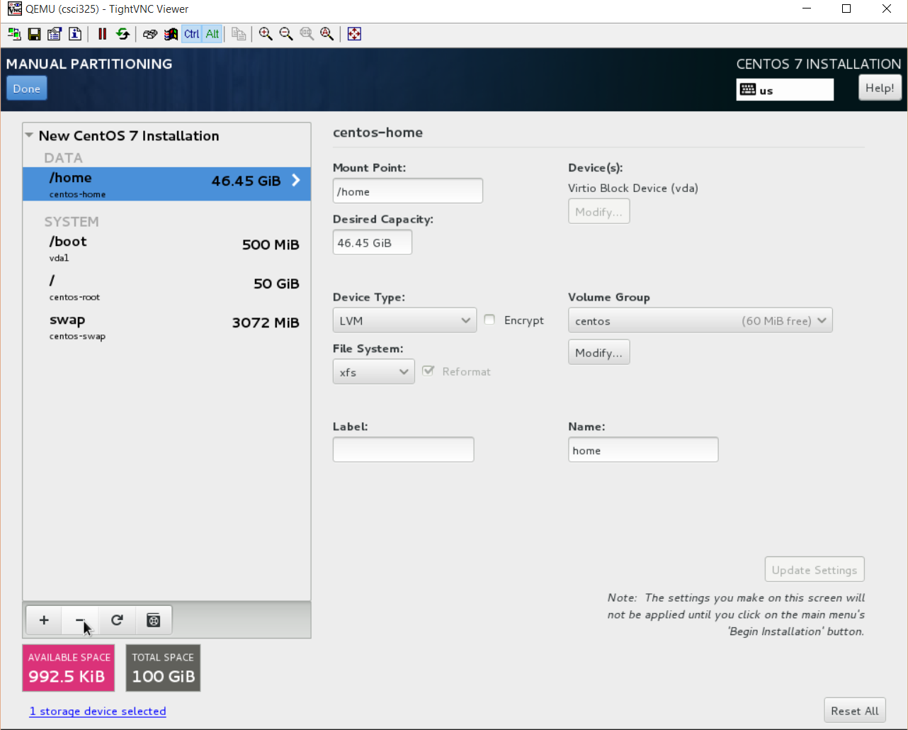
Install
Remove /home filesystem
  Click on /home, then click on minus sign

Slide 61
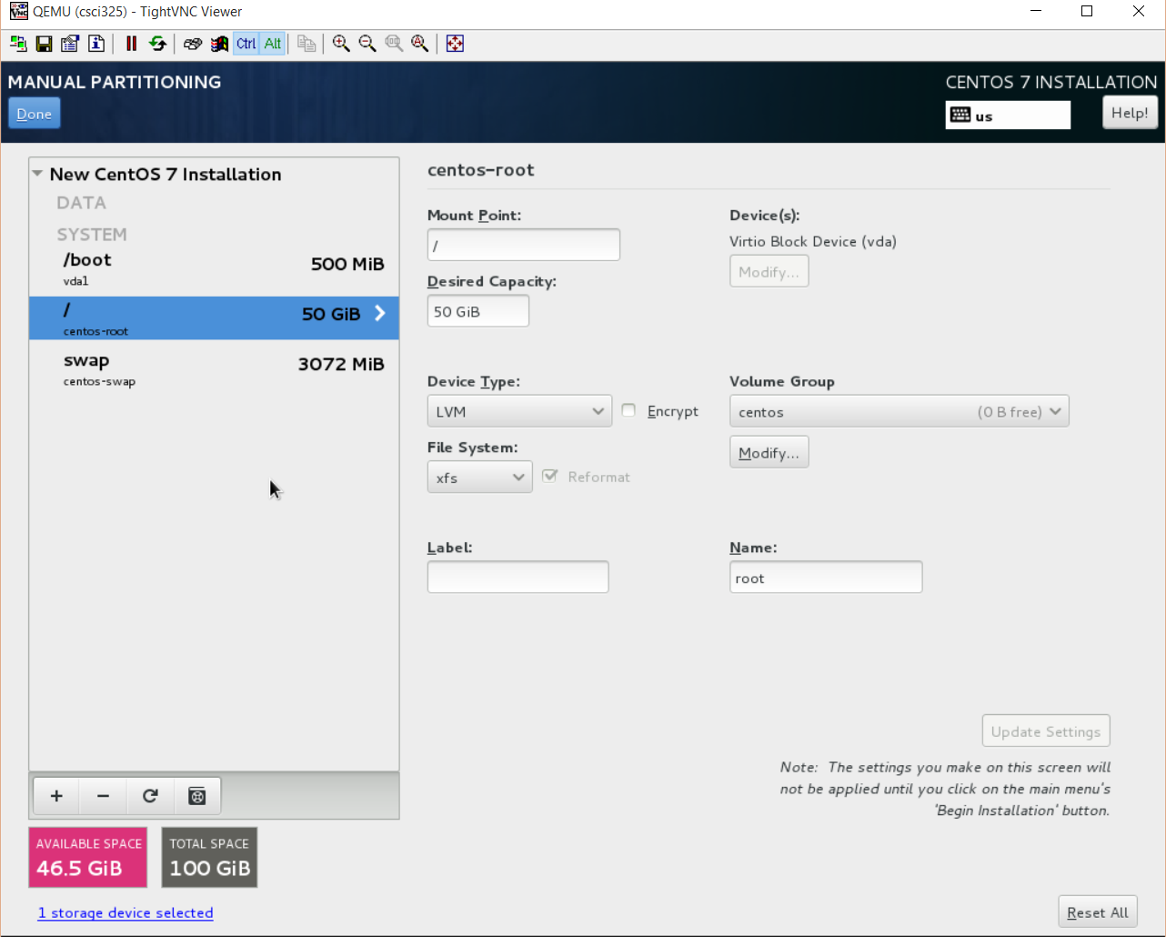
Install
Change / (root partition) size to 50 GiB
Ensure you have at least 5GB of available space
  Lower left corner
Click Done

Slide 62
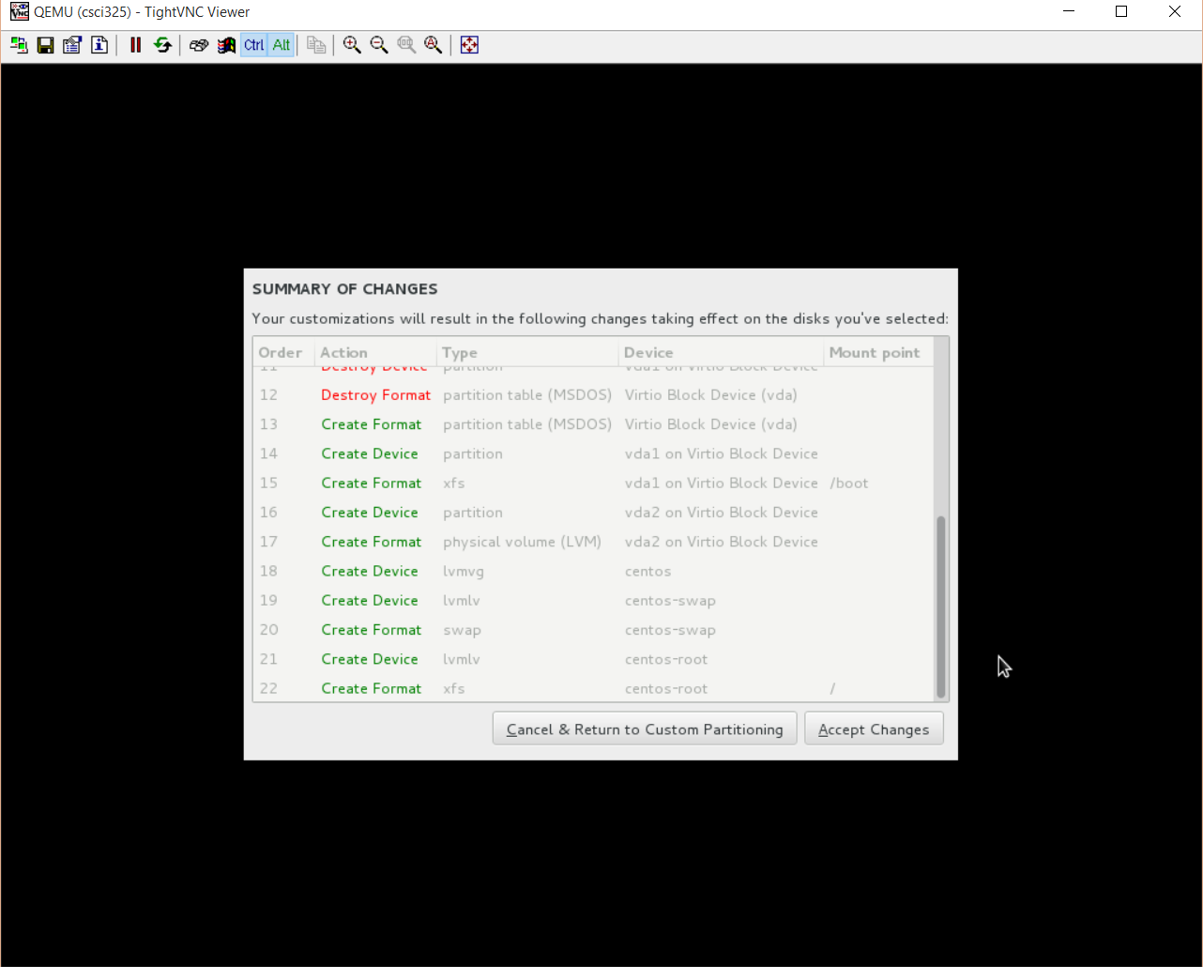
Install
Up until now, no changes have been written to disk. This screen gives us one last chance to cancel our changes.
Press cancel to return to the previous screen and validate your settings
Accept changes when satisfied

Slide 63
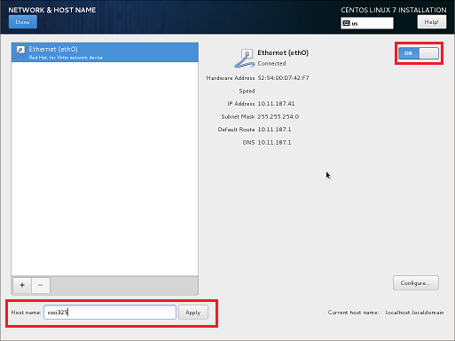
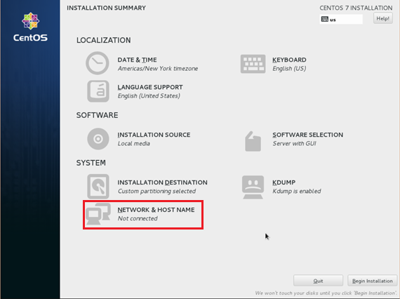
Install
Set hostname and network
  Can be changed later
  Makes things easier now
  Use short hostname
  Turn networking on

Slide 64
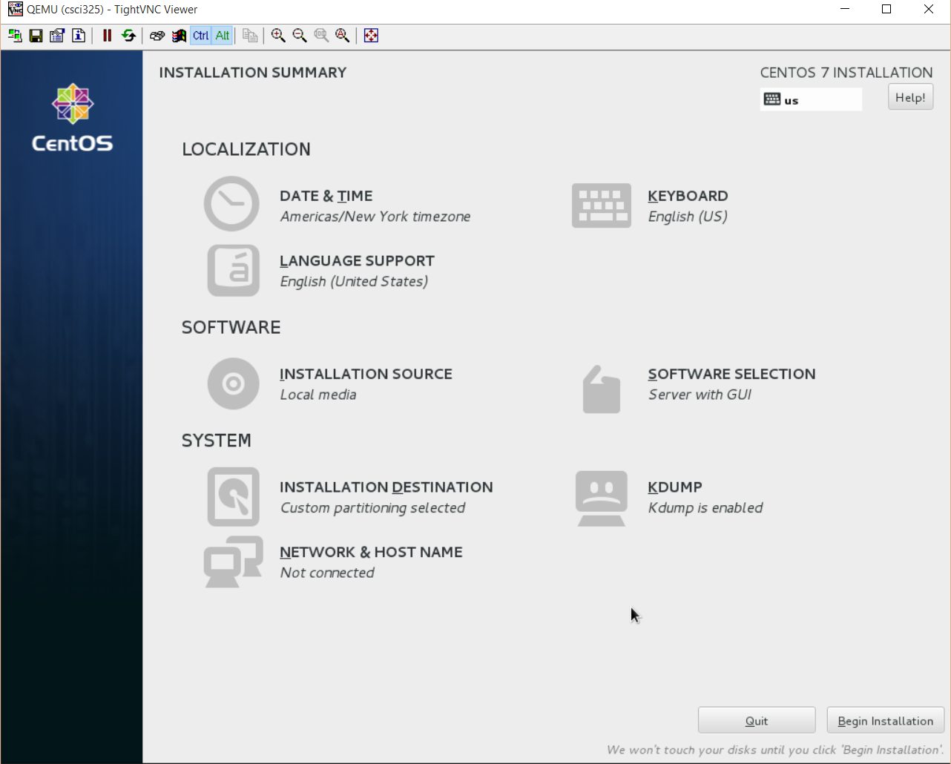
Install!
Begin Install!

Slide 65
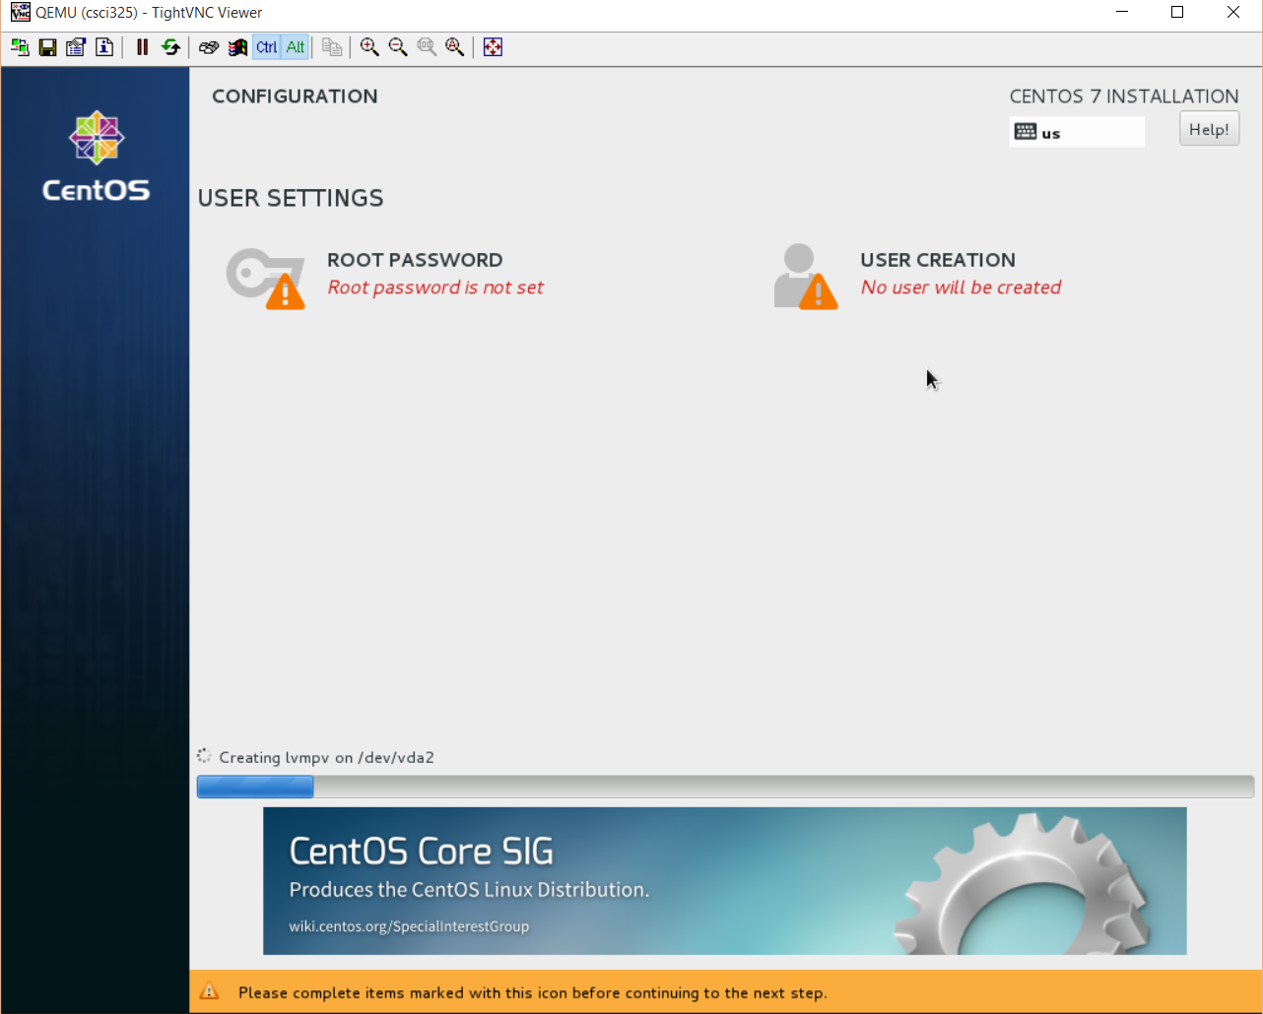
Install
Installation Starts
Action items to complete
  Set local root (superuser/administrator) password
  Create a local account (optional)

Slide 66
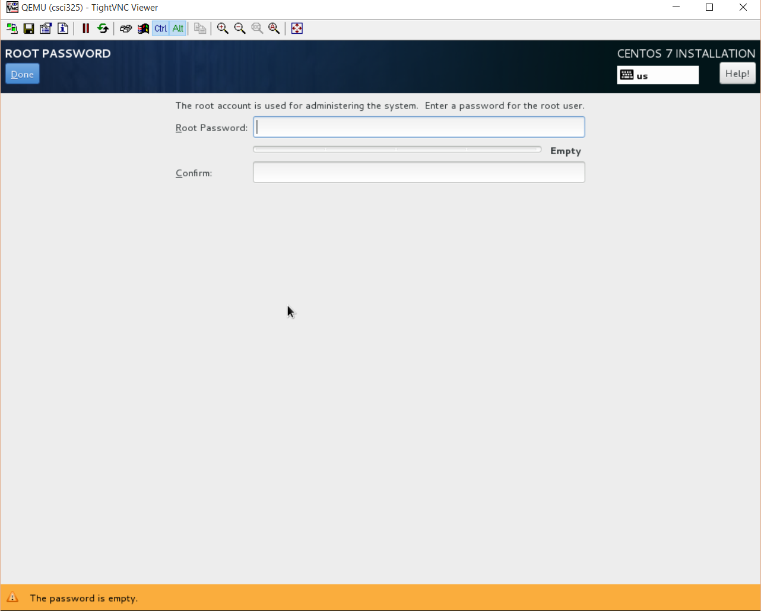
Install
Set a root password
Notice any messages displayed in the yellow bar at the bottom of the screen

Slide 67
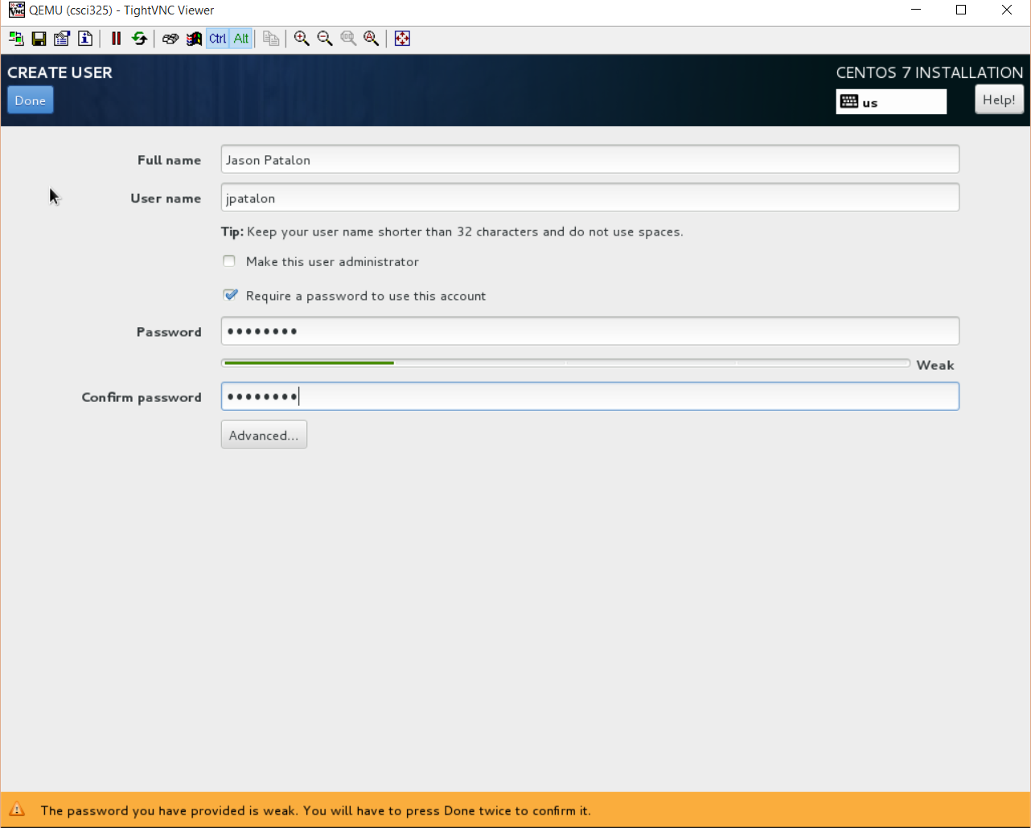
Install
Create a local user
Use your full first and last name
User name should be in the format of first letter of first name, followed by last name
Do not make this user an administrator
Notice any relevant messages in the yellow bar at the bottom of the screen
Our VM’s are already configured

Slide 68
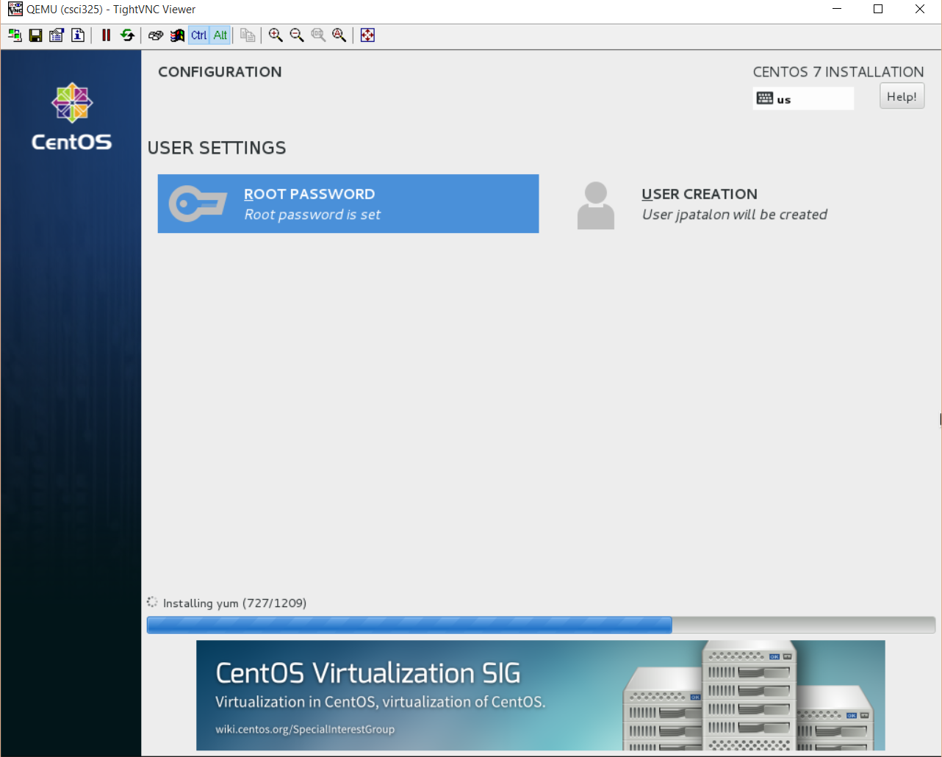
Install
Wait for installation to finish…

Slide 69

Installing Linux…
Hardware Compatibility List (HCL)
  Specifies what hardware will work (what has been tested and verified)
  Typically avoid cutting edge hardware in the data center
Server Characteristics
  Stability
  Availability
  Performance
Only install what is necessary
  Limited number of startup services
  Limited number of installed applications
    No GUI?!
  Software optimizations
    Kernel

Slide 70
Installing Linux…
Installation Methods
  Network
    HTTP, FTP, HTTPS, NFS, SMB, PXE
  CD/DVD
    Disc, ISO
Scripted
  Combination of an installation method and
  custom installation commands
    Customize an installation for your environment!
    Easily repeatable!

Slide 71
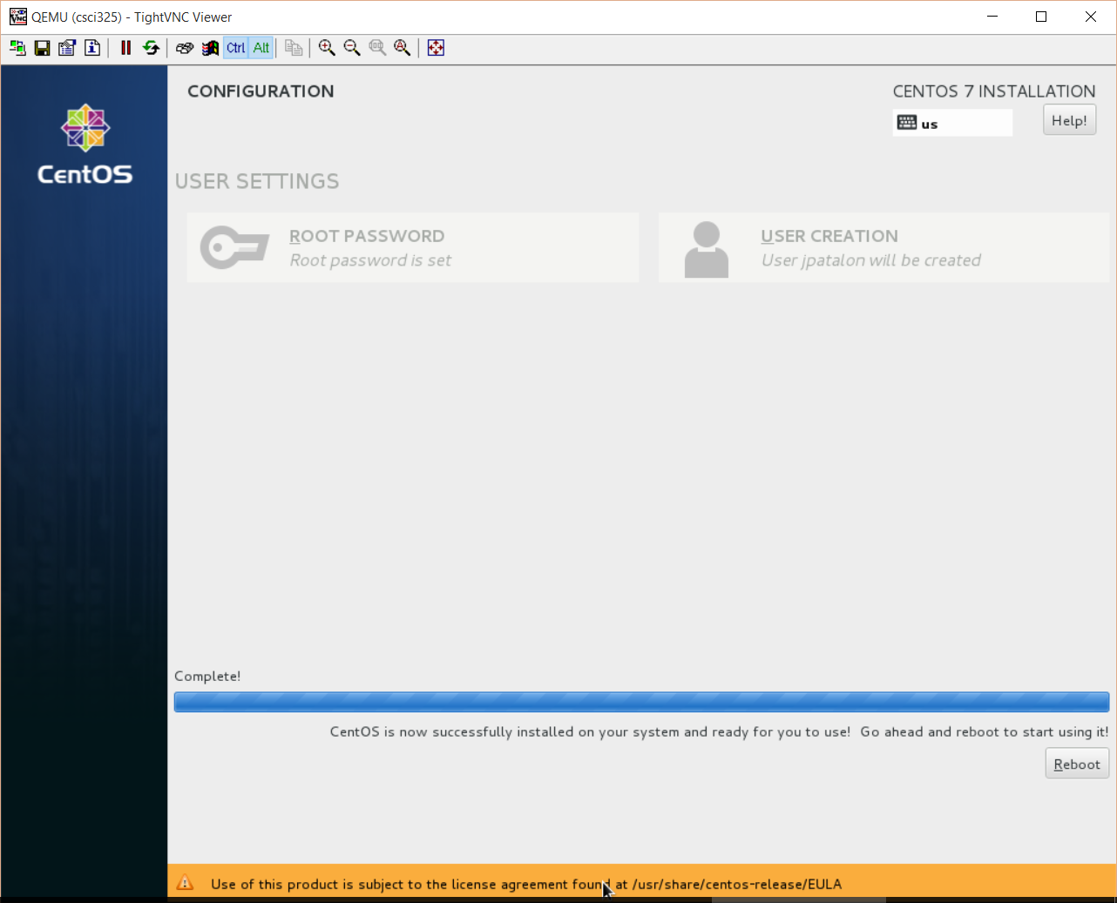
Install – Physical Machines
Reboot to finish installation
Commands scroll on screen
Disc will eject and machine will reboot
  Allow extra time for first boot
  If prompted to accept a license agreement, press 1, 2, c, c to accept the license and continue booting
Log in, complete Gnome initial setup
  English, next
  English (US), next
  Start Using

Slide 72
Install – Virtual Machines
Reboot to finish installation
Commands scroll on screen
ISO tries to boot again
  We could select boot from local disk…
  Power off VM
  Change boot order
  Reboot

Slide 73
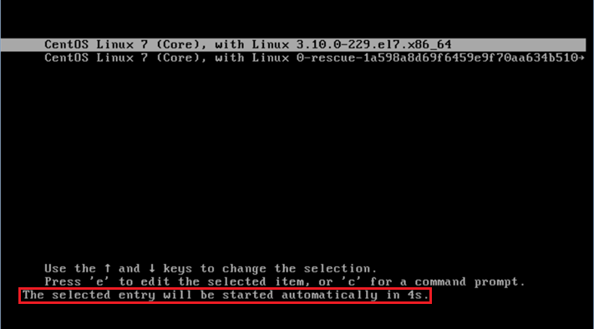
First Boot
OS Boot Options
  Press E to edit advanced
  options
Press enter to boot now
  Or wait 5 seconds to
  automatically boot
Each new kernel install will add
an additional boot line
Press <esc> during boot
to show boot messages

Slide 74
Configure – Wi-Fi Install
Install Wi-Fi drivers
  Insert DVD, select Open with Files when prompted
  Open Packages Folder
  Search for NetworkManager-wifi package
  Right click package file, observe available options. Select Open with Software Install
  Click Install, enter administrator (root) password when prompted
  Eject DVD and reboot
WiFi Config
EUP Wi-Fi Connection Instructions
  Wi-Fi Security: WPA & WPA2 Enterprise
  Authentication: Protected EAP
  No CA Certificate required
  Inner Authentication: MSCHAPv2
  Username: (EU_Username)
  Password: (EU_Password)
This is old,
here for reference
Laptops Only

Slide 75
Configure – Alternate Wi-Fi Install
Alternate Wi-Fi drivers installation
  Insert DVD, select Open with Files when prompted
  Open Packages Folder
  Search for NetworkManager-wifi package
  Copy the package to your desktop
  Right click on the desktop, and select open in terminal
  Use the su command to become root
  Use the ls command to list the contents of the directory
  Install the package with the following command:
    rpm -Uvh NetworkManager-wifi*.rpm
    Note the command above is case sensitive!!!
WiFi Config
EUP Wi-Fi Connection Instructions
  Wi-Fi Security: WPA & WPA2 Enterprise
  Authentication: Protected EAP
  No CA Certificate required
  Inner Authentication: MSCHAPv2
  Username: (EU_Username)
  Password: (EU_Password)
This is old,
here for reference
Laptops Only

Slide 76
ECSC 325.200
Web Server Administration
Spring 2025 – Week 3-2 – January 30th, 2025
Quick reviews, DNS Intro, Linux Basics, and Operating System Installs

Slide 77

Connecting to our VM’s
New method of connecting to CS Network
Connect to VPN
  Windows Thick Client
  Windows L2TP
  MacOS L2TP
  Chromebook/Linux L2TP?
    Untested…
EUP-CS VPN
  Remote host: 147.64.2.12 (vpn.cs.edinboro.edu or vpn.ultrastuff.net)
  Pre-Shared Key: <credentials.txt>
  Username and password for students
    Username: <credentials.txt>
    Password: <credentials.txt>
Creds in credentials.txt

Slide 78
Create a VPN Connection – Windows Client
Windows – Sonicwall VPN Client
  Download and install the client
    https://software.sonicwall.com/GlobalVPNClient/184-011921-00_REV_A_GVCSetup64.exe
  Give the connection a name: EUP-CS VPN
  Remote host: 147.64.2.12 (vpn.cs.edinboro.edu or vpn.ultrastuff.net)
  Pre-Shared Key: <credentials.txt>
  Username and password for students
    Username: <credentials.txt>
    Password: <credentials.txt>
  Enable the connection!
Creds in credentials.txt

Slide 79
Create a VPN Connection – Windows L2TP
Windows – Layer 2 Tunneling Protocol (L2TP/IPsec)
  Start → Settings → Network & Internet → VPN
    Add VPN
  Give it a name: EUP-CS VPN
  Server address: 147.64.2.12 (vpn.cs.edinboro.edu or vpn.ultrastuff.net)
  VPN Type: L2TP/IPSec with pre-shared key
  Pre-Shared Key: <credentials.txt>
  Username and password for students
    Username: <credentials.txt>
    Password: <credentials.txt>
  Connect on the VPN network!
  You may need to enable the option to tunnel all traffic through the VPN…
Creds in credentials.txt

Slide 80
Create a VPN Connection – MacOS L2TP
Mac OS – Layer 2 Tunneling Protocol (L2TP/IPsec)
  System Preferences → Network
    Three dots in lower right corner → Add VPN Config → L2TP over IPSec
  Give it a name: EUP-CS VPN
  Server address: 147.64.2.12 (vpn.cs.edinboro.edu or vpn.ultrastuff.net
  Pre-Shared Key: <credentials.txt>
  Username and password for students
    Username: <credentials.txt>
    Password: <credentials.txt>
  Connect on the VPN network!
  You may need to enable the option to tunnel all traffic through the VPN…
Creds in credentials.txt

Slide 81
Create a VPN Connection – Chromebook L2TP/IPsec
Chromebook – Layer 2 Tunneling Protocol (L2TP/IPsec)
  Settings→ Network
  Add built-in VPN → Add connection
  Give it a name: EUP-CS VPN
  Authentication type: Pre-shared key
  Server hostname: 147.64.2.12 (vpn.cs.edinboro.edu or vpn.ultrastuff.net)
  Pre-Shared Key: <credentials.txt>
  Username and password for students
    Username: <credentials.txt>
    Password: <credentials.txt>
  Connect on the VPN network!
  You may need to enable the option to tunnel all traffic through the VPN…
  https://support.google.com/chromebook/answer/1282338?hl=en#zippy=%2Cltpipsec-vpn-support
Creds in credentials.txt

Slide 82
Connect to CS VPN with a SSH Connection
Open a command prompt terminal
    In Windows, a cmd shell or powershell
    In Linux, your default command line shell
  SSH to the server jpatalon.cs.edinboro.edu on port 54321
    You will need to use the format of username@jpatalon.cs.edinboro.edu to specify the
    correct username when connecting!
    The username and password are contained in the credentials file within D2L
  Example connection commands
    ssh user@jpatalon.cs.edinboro.edu -p 54321
Creds in credentials.txt
ssh cs_student@jpatalon.cs.edinboro.edu –p 54321

Slide 83
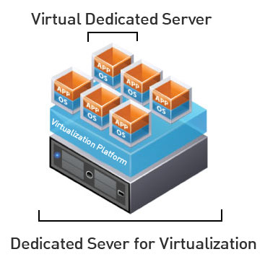
Connecting to our VM’s
IP Address: 147.64.243.1## (01-25)
  Use your two digit number from below!
Hostname: ecsc325-1##.cs.edinboro.edu (01-25)
  Use your two digit number from below!
Default root password: <credentials.txt>
Two digit number:
  Tanner A: 01
  Freyja B: 02
  Osaretin I: 03
  Derek J: 04
  Benjamin K: 05
  Dennis V: 06
Aliases will be used in the future…

Slide 84

Assignment 3
Assignment 3 tasks – 40 Points – Due February 5th, 2025
  Change password for root and user accounts
  Install s-nail, curl, wget, net-tools, nano, and sendmail
  Create root ssh keys
  Import root@ecsc325-110 SSH key
  Disable SELinux
  Update and reboot!
  DOCUMENTATION!!!
    I changed the password of the root and user accounts using the command passwd
    I ran the following command to install the curl, wget, mailx, and nano packages:
        dnf -y install curl wget mailx nano
    Edit the /etc/selinux/config file, changing the SELINUX= line to permissive:
      SELINUX=permissive
    Downloaded the professor’s public SSH key, and added to my accepted keys file
      /root/.ssh/authorized_keys

Slide 85
Configure
Ensure you can log in to your machine as root
  Login via ssh must now happen after establishing VPN connection
  You can run putty and connect directly to your VM on port 22 while on campus
  You can also SSH to cslab100/cslab101 from anywhere, then SSH to your VM (proxy!)
Change root account password
  passwd root
Add user account and change account password
  adduser user
  passwd user
Install curl, wget, mailx, and nano
  dnf install s-nail curl wget nano net-tools
    Add -y for yes!

Slide 86

Configure
Install and configure sendmail
  This allows the checkscript to send email results directly to the professor
  dnf install sendmail
  systemctl enable sendmail --now
Create an SSH key pair as root (accept all defaults by pressing enter)
  ssh-keygen
  This sets up the appropriate folders and files for our SSH key based logins, and creates unique public and private keys for our root user
Add root@ecsc325-110 ssh login authorized key
  This allows professor to log on to your VM for assistance securely without a password
  cd /tmp
  curl -O https://jpatalon.ultrastuff.net/ecsc325/classfiles/root@ecsc325-110.pubkey
  cat /tmp/root@ecsc325-110.pubkey >> /root/.ssh/authorized_keys

Slide 87
Configure
Set SELinux as permissive
  Edit the file /etc/selinux/config
  Change just the SELINUX= setting to permissive!!!
      SELINUX=permissive
  Reboot to apply change, or disable immediately with setenforce 0
Update system from the command line
  Run command dnf update kernel and follow the prompts
    This will update only the kernel (and any dependencies/requirements)
      NEVER REBOOT WHILE UPDATING THE KERNEL!!!
  Run command dnf update and follow the prompts to update everything
    This may take 5-10 minutes or more to complete! Don’t restart during this time!
Reboot with the reboot command!
  DON’T REBOOT WHILE YUM/DNF IS RUNNING!!!

Slide 88

SELinux
Security Enhanced Linux
A kernel security module that provides advanced access control mechanisms (mandatory access controls; MAC)
Uses rules to allow or deny access to or execution of files
Similar to AppArmor on SUSE and Ubuntu
We want to set SELinux permissive for our class!
  If you don’t, it will cause issues later!
  Boot time set in file /etc/selinux/config
  Runtime set with setenforce 0
  Status checked with sestatus

Slide 89
Linux Directory Structure
Root – Top level directory
  Represented by a forward slash /
  Similar to C:\ on Windows
/bin – User applications (binaries)
/sbin – System applications
/etc – Config files
/dev – Device files
  Virtual file systems!
/proc – Process Information
/var – Variable files
  /var/log – Log files
/usr – User programs
/opt – Additional optional programs
/home – Home directories
/root – Root user home directory
/boot – Boot loader files
/lib – System library files
/mnt – Mount directory
/tmp – Temporary files

Slide 90
Logical Volume Management
Disks (Physical Volumes)
  Physical devices storing data
  Can be RAID devices
  Can be virtual disks presented to an OS as a physical device!
    LUNs in a SAN system, virtual disks in a virtual guest environment
Partitions
  Separate regions of disks
Volume groups
  Groups of disks or partitions
Logical volumes
  Individual volumes within a volume group
File systems
  Specifies how data is stored and organized
Notes:
Typically you will see a single disk (/dev/sda or similar), two partitions (/boot and a vol group), one or more logical volumes (separate /home or /var), on an ext3/4 or xfs file system.

Slide 91
Logical Volume Management
Mount points
  Where is this storage mapped to within the filesystem
  /, /var, /home, /opt, /mnt
df -h command
  Show disk space usage in a human-readable format
free command
  Show RAM and swap usage
Physical Disk SDA
  Physical Volume: Partition SDA1: Boot volume
  Physical Volume: Partition SDA2: Centos volume group
    Root logical volume, mounted at /
    Swap logical volume, mounted as swap
Notes:
Typically you will see a single disk (/dev/sda or similar), two partitions (/boot and a vol group), one or more logical volumes (separate /home or /var), on an ext3/4 or xfs file system.

Slide 92

File Types
Normal Files
  Text files, executables, binary files, etc.
Directories
  Folders
  Can contain files or directories within
Links
  Hard links point to i-nodes
    An i-node keeps track of a files location and attributes
    Hard links can only refer to files on the same filesystem
  Symbolic links point to file names
    Similar to a shortcut
    Can point to files on any accessible file system

Slide 93
File Types
Block Devices
  Represent block devices connected to a system, such as a disk
  Communicate with devices in blocks (1k, 2k, 4k, 8k, etc)
  Ex: /dev/sda (hard disk 1)
    /dev/sda1 is partition 1 on disk sda
Character Devices
  Represent character devices connected to a system, such as a modem
  Communicate with devices one character at a time
  Ex: /dev/ttyS0
Named Pipes
  Allows for inter-process communication
  One process can write to a pipe, another can read

Slide 94

Managing users and groups
Every user has a unique User ID (UID)
  Unique per system (or directory service (AD, LDAP, etc))
Users are members of one or more groups
  Each group has a unique Group ID (GID)
  Unique per system (or directory service (AD, LDAP, etc))
Two types of users
  Normal Users
  Root Users
User information storage location
  /etc/passwd
  /etc/shadow
  /etc/group

Slide 95
Managing users and groups
Basic user information is stored in /etc/passwd
  Username:password:UID:GID:GECOS:home:shell
  Password field has an x to represent shadow passwords
  Shadow passwords use /etc/shadow file
  UID and GID are unique per system
    Central directory can standardize ID’s
  GECOS Field can store various info
    Name, office, phone, etc.
    General Electric Comprehensive Operating System
  Home Directory
    User’s default storage location
    Contains user-specific startup scripts
  Shell
    User’s default shell
Primary Group!

Slide 96
Managing users and groups
Password information stored in /etc/shadow
  USERNAME:PASS:X:X:X:X::::
    Username
    Encrypted (hashed) Password
      $id$salt$hashed
    Days since 1/1/1970 password last changed
    Days before password can be changed
    Days until password must be changed
    Warning issued this many days early
    Two account disable information fields
    Reserved field

Slide 97
Managing users and groups
Group information stored in /etc/group
  GROUPNAME:PASS:GID:group members
  Groupname
  Encrypted group password
  Group ID
  Comma separated list of group members
  Only secondary groups are listed here!
  Primary group is listed within the passwd file
Secondary Groups!

Slide 98
Managing users and groups
useradd – Add users to a system
  Usage: useradd [options] LOGIN
usermod – Modify an existing user on a system
  Usage: usermod [options] LOGIN
  usermod -e 2018-12-31 jpatalon
  usermod -a -G group user
userdel – Delete an existing user from a system
  Usage: userdel [options] LOGIN
groupadd – Add a group to a system
  Usage: groupadd [options] GROUP
groupmod – Modify an existing group on a system
  Usage: groupmod [options] GROUP
groupdel – Delete an existing group
  Usage: groupdel GROUP
There are GUI tools as well…

Slide 99

Managing Permissions
chown – Change file owner (and optionally group)
  Ex: chown jason /root/folder/file.txt
  Ex: chown jason:admin /root/folder/file.txt
chgrp – Change file group only
  Ex: chgroup admin /root/folder/file.txt
chmod – Change file permissions
  Ex: chmod 750 /root/folder/file.txt
  Ex: chmod ug+rwX,o-rwx /root/folder/file.txt

Slide 100
Permissions
Octal Modes
  1 – Execute
  2 – Write
  3 – Write & Execute
  4 – Read
  5 – Read & Execute
  6 – Read & Write
  7 – Read, Write, & Execute
Octal modes are set, overwriting any current modes that are already set
  Ex: chmod 750 /root/folder/file.txt
Symbolic Modes
  u = user
  g = group
  o = other
  a = all
  r = read
  w = write
  x = execute
Symbolic modes can be additive and subtractive, adding to or removing from currently set permissions
  Ex: chmod ug+rwX,o-rwx /root/folder/file.txt

Slide 101
Permissions
Basic Permissions:
  (R) – Read Permission
  (W) – Write Permission
  (X) – Execute Permission
  (-) – No permission set
Basic Users:
  User – The owner of the file
  Group – The group that owns the file
  Other – Everyone else (world)
File Types (first character):
  (d) – Directory
  (l) – Link (shortcut)
  (-) – File
File permissions are read as follows:
  -rwxrwxrwx root:root filename.txt
  First character represents directory, link, or file.
  Characters 2,3,4 represent owner permissions
  Characters 5,6,7 represent group permissions
  Characters 8,9,10 represent world permissions
SetUID – Run program as the owner
  chmod u+s [filename]
SetGID – Run program as group
  chmod g+s [filename]

Slide 102

Pluggable Authentication Modules (PAM)
PAM allows for multiple different authentication rules
PAM can authenticate local users as well as LDAP or Active Directory users
PAM allows for many different options
  Required – states something must succeed for authentication success
  Requisite – stops all processing if failure
  Sufficient – Will return success if authentication success
  Optional – Failure does not deny authentication success
Easy to break things in PAM!
PAM provides a flexible and centralized way to auth users
across various apps, by use of pluggable modules
  Password, Kerberos, etc.

Slide 103
The Command Line
The Bourne Again Shell (BASH)
  Command line interface to the system
  Allows you to run commands and launch other programs
  Many built in features
Backgrounding processes
  Add ampersand (&) to the end of a command
Environment Variables
  Can be used on command line or in scripts
  Set, export, call, unset
[root@ecsc325 ~]# VARIABLE1="Hello World"
[root@ecsc325 ~]# export VARIABLE1
[root@ecsc325 ~]# echo $VARIABLE1
Hello World
[root@ecsc325 ~]# printenv VARIABLE1
Hello World
[root@ecsc325 ~]# unset VARIABLE1
[root@ecsc325 ~]#

Slide 104
The Command Line
cat
  Concatenate a file
  Output to screen or send to another program
Pipes (|)
  Redirect output to another program
  [root@ecsc325 ~]# cat /var/log/messages | wc
Redirection (> or >>)
  Single greater than will overwrite a file
  Double greater than will append to a file
history
  List of previously executed commands
cd
  Change Directory
  Ex: cd /var/log
pwd
  Show present working directory
  Ex:
    [root@ecsc325 log]# pwd
    /var/log
touch
  Create a blank empty file
  Ex: touch /tmp/file.txt

Slide 105
The Command Line
Common shortcuts
  Pressing the up arrow will let you scroll through recent commands
  Wildcards can be used in filenames
Tab Complete
  Pressing tab once will complete the text of a command or file
  Pressing tab twice will show a list of matching files or commands
  Ex: type “ls /var/log/mess” and press tab once, then twice, then a bunch of times.
    [root@ecsc325 ~]# ls /var/log/messages
    messages messages-20160214
Manual pages (man command)
  Ex: man which or man 1 which
  Various sections, for commands, kernel calls, C library calls, etc.

Slide 106
The Command Line
Files, file types, file ownership, file permissions
  ls command will show us these items
  ls is short for list
  ls command can take many options
    -l gives the long listing (lower case L)
    -a gives all files, including hidden files
      Hidden files start with a period in the filename
        Ex: .bash_profile, .ssh
    -t sorts by modified time
    -r reverse
    -h human readable
The ls command (lowercase LS)

Slide 107
The Command Line
Files, file types, file ownership, file permissions
  [root@ecsc325 ~]# cd /var/log
  [root@ecsc325 log]# pwd
  /var/log
  [root@ecsc325 log]# ls
  anaconda gdm pm-powersave.log tallylog
  audit glusterfs ppp tuned
  boot.log grubby qemu-ga wpa_supplicant.log

Slide 108
The Command Line
Files, file types, file ownership, file permissions
  [root@ecsc325 log]# ls
  anaconda gdm pm-powersave.log tallylog
  audit glusterfs ppp tuned
  boot.log grubby qemu-ga wpa_supplicant.log
ls

Slide 109
The Command Line
Files, file types, file ownership, file permissions
  [root@ecsc325 log]# ls -l
  total 1436
  drwxr-xr-x. 2 root root 4096 Feb 11 19:07 anaconda
  drwxr-x---. 2 root root 22 Feb 11 19:08 audit
  -rw-r--r--. 1 root root 12597 Feb 14 10:15 boot.log
  -rw-------. 1 root utmp 0 Feb 11 19:51 btmp
  drwxr-xr-x. 2 chrony chrony 6 Nov 23 16:35 chrony
  -rw-r--r--. 1 root root 56923 Feb 16 18:50 cron
  -rw-r--r--. 1 root root 56037 Feb 14 03:35 cron-20160214
  drwxr-xr-x. 2 lp sys 80 Feb 14 03:35 cups
ls

Slide 110
The Command Line
Files, file types, file ownership, file permissions
  [root@ecsc325 log]# ls -la
  total 1444
  drwxr-xr-x. 16 root root 4096 Feb 14 10:15 .
  drwxr-xr-x. 22 root root 4096 Feb 14 10:15 ..
  drwxr-xr-x. 2 root root 4096 Feb 11 19:07 anaconda
  drwxr-x---. 2 root root 22 Feb 11 19:08 audit
  -rw-r--r--. 1 root root 12597 Feb 14 10:15 boot.log
  -rw-------. 1 root utmp 0 Feb 11 19:51 btmp
  drwxr-xr-x. 2 chrony chrony 6 Nov 23 16:35 chrony
  -rw-r--r--. 1 root root 56923 Feb 16 18:50 cron
  -rw-r--r--. 1 root root 56037 Feb 14 03:35 cron-20160214
  drwxr-xr-x. 2 lp sys 80 Feb 14 03:35 cups
ls

Slide 111
The Command Line
Files, file types, file ownership, file permissions
  [root@ecsc325 log]# ls -lah
  total 1.5M
  drwxr-xr-x. 16 root root 4.0K Feb 14 10:15 .
  drwxr-xr-x. 22 root root 4.0K Feb 14 10:15 ..
  drwxr-xr-x. 2 root root 4.0K Feb 11 19:07 anaconda
  drwxr-x---. 2 root root 22 Feb 11 19:08 audit
  -rw-r--r--. 1 root root 13K Feb 14 10:15 boot.log
  -rw-------. 1 root utmp 0 Feb 11 19:51 btmp
  drwxr-xr-x. 2 chrony chrony 6 Nov 23 16:35 chrony
  -rw-r--r--. 1 root root 56K Feb 16 18:50 cron
  -rw-r--r--. 1 root root 55K Feb 14 03:35 cron-20160214
  drwxr-xr-x. 2 lp sys 80 Feb 14 03:35 cups
ls

Slide 112
The Command Line
Files, file types, file ownership, file permissions
  chown, chgrp, chmod
    Modify owners, groups, and permissions
  Examples:
    chown jpatalon /tmp/file.txt
    chown jpatalon:admin /tmp/file.txt
    chgrp admin /tmp/file.txt
    chmod u+rw,g+r,o-rwx /tmp/file.txt
File permissions are read as follows:
  -rwxrwxrwx root:root filename.txt
  First character represents directory, link, or file.
  Characters 2,3,4 represent owner permissions
  Characters 5,6,7 represent group permissions
  Characters 8,9,10 represent world permissions
Symbolic Modes
  u = user a = all
  g = group X = traverse folder
  o = other S = setuid/setgid
  r = read s = setuid/setgid + x
  w = write T = sticky
  x = execute t = sticky + x
Notes:
Setuid and setgid allow users to run an executable with the permissions of the executable's owner or group respectively.
When a directory's sticky bit is set, the filesystem treats the files in such directories in a special way so only the file's owner, the directory's owner, or root user can rename or delete the file.

Slide 113
Permissions
Octal Modes
  1 – Execute
  2 – Write
  3 – Write & Execute
  4 – Read
  5 – Read & Execute
  6 – Read & Write
  7 – Read, Write, & Execute
Octal modes are set, overwriting any current modes that are already set
  Ex: chmod 750 /root/folder/file.txt
Symbolic Modes
  u = user
  g = group
  o = other
  a = all
  r = read
  w = write
  x = execute
Symbolic modes are additive and subtractive, adding to or removing from currently set permissions
  Ex: chmod ug+rwX,o-rwx /root/folder/file.txt
Octal modes set permissions, symbolic modes can add and remove

Slide 114
The Command Line
File manipulation and navigation
  ln command – lets us create links (like shortcuts)
    Ex: ln -s original_file new_shortcut
    -s represents a symbolic link
  find command – lets us find files
    Ex: find location -name “filename*”
    Ex: find / -name “asdf.exe”
  cp command – copy a file
    Ex: cp file1.txt file2.txt
  mv command – move a file
    Ex: mv file1.txt file3.txt
  mkdir command – make a directory
    Ex: mkdir /tmp/folder
Moving is the same as renaming!

Slide 115
The Command Line
File manipulation and navigation
  rmdir command – remove a directory
    Ex: rmdir /tmp/folder
  pwd – Present Working Directory
    Displays which directory you are currently in
    Ex: pwd
  cat command - concatenate a file
    Output to screen or send to another program
    Ex: cat /folder/file.txt
  more – display text one screen at a time
    Ex: more /folder/file

Slide 116
The Command Line
File manipulation and navigation
  du command – show current disk utilization of a folder
    Ex: du –sh /var
  df command – show all current disk and drive utilization overview
    Ex: df –h
    The -h makes it “human readable” or displays sizes in familiar units (KB, GB, TB, etc.)
  which command – show location of a file
    Ex: which df
  whereis command – Shows the program, source, and manual page locations
    Ex: whereis df
which man? man which?

Slide 117
The Command Line
File compression
  gzip – Allows to create gz compressed files
    Ex: gzip /tmp/file.txt
    Resulting file will be compressed and named /tmp/file.txt.gz
    Most commonly used compression on Linux
    Can only compress one file into one file! Cannot compress multiple files into a single compressed file.
    Files decompressed with –d flag (or gunzip command)
      Ex: gzip –d /tmp/file.txt.gz or gunzip /tmp/file.txt.gz
      Resulting file would be named /tmp/file.txt
  bzip2 – Allows to create bz2 compressed files
    Similar to gzip, offers better compression than gzip
    Ex: bzip2 /tmp/file.txt
    Resulting file will be named /tmp/file.txt.bz2
    Files can be decompressed with -d flag (or bunzip2 command)

Slide 118
The Command Line
File compression
  tar – Tape Archiver
    Allows for combining multiple files into a single file
    Does not offer any compression
    Ex: tar –xf file.tar file1 file2 file3
    One can use tar to combine multiple files into a single file, then compress that single file using one of the previously mentioned tools.
Tar the files then gzip the tar file to create a tarball!

Slide 119
The Command Line
Additional system and file management tools
  ps – list running processes for one or all users
    Ex: ps aux
    Many different options are available
  top – display interactive list of processes
    Ex: top
    Exit by pressing q
  kill – kill a running process
    Ex: kill -9 12345
    Kill requires a Process ID (PID)
    PID can be found through ps or top commands
  head – display only the first lines in a file
    head -n 20 filename.txt
  tail – display the last lines in a file
  who – display list of logged in users
  w – display logged in users, uptime, and system load
  su – switch user command
    Switch to impersonate another user (root)
  sudo – Super User Do
    Run a single command as another user (root)

Slide 120

Package Management
yum – Manage installed packages and software
  Red Hat and similar systems (Fedora, CentOS, etc)
  Maintains a list of packages and dependencies
  yum search <package>
  yum install <package>
  yum update
RPM – RedHat Package Manager
  Package format for RedHat Software
  RPM’s Can be installed through yum/dnf or separately
  Display list of all installed packages
  Query package details
DNF – Next generation of Yum – Replaces yum!
  Dandified Yum? What?
RPM describes the package format
YUM maintains RPM’s and dependencies

Slide 121
Documentation Expectations
Documentation expectations examples:
  Edit the network configuration file /etc/sysconfig/network-scripts/ifcfg-bond0
    Updated the following information in the network configuration file:
      IPADDR=147.64.243.115
      HOSTMASK=255.255.254.0
      DNS1=147.64.242.100
      DNS2=147.64.242.101
  Restarted the network services to apply configuration changes
      systemctl restart network
  Added entry to /etc/fstab file for persistent mount
    147.64.243.115:/data /data nfs bg,rw,sync,hard,intr 0 0
  Updated and rebooted the system
      dnf –y update; reboot

Slide 122
Virtual Machines
IP Address: 147.64.243.1## (01-25)
Hostname: ecsc325-1##.cs.edinboro.edu (01-25)
Alias: 1##.megastuff.biz (01-25)
  1##.ultrastuff.net and others…
Default root password: <credentials.txt>
Assignment 3 tasks – 40 Points
  Change password for root and user accounts
  Install s-nail, curl, wget, net-tools, nano, and sendmail
  Create root ssh keys
  Import root@ecsc325-110 SSH key
  Disable SELinux
  Update and reboot!
  DOCUMENTATION!!!
Aliases will be used in the future…

Slide 123
Check Scripts
Run the check script for the week!
1. Download the check script
    curl -O http://jpatalon.cs.edinboro.edu/ecsc325/classfiles/assignment3check.sh
    That is a capital letter -O above!
2. Set the script executable
    chmod a+x ./assignment3check.sh
    Give the execute permission to all users!
3. Execute the script
    ./assignment3check.sh
4. Follow the prompts in the script!
    Enter your name
    Watch for feedback
    Submit file to professor when ready!

Slide 124
Linux Commands
ssh
virsh
su
sudo
vi
nano
gedit
cd
echo
wget
cat
hostname
mkdir
useradd
passwd
yum/dnf
man
passwd
ssh-keygen
history
tcpdump
route
ifconfig
ip
nmcli
netstat
nslookup
dig

Slide 125

Key Terms and Items
Command Line Interface (CLI)
Security Enhanced Linux (SELinux)
Manual Pages
Linux Directories
  /, /root, /etc, /home
Secure Shell (SSH)
  Tunnels
Virtual Network Computing (VNC)
Remote Desktop Protocol (RDP)
In-Band
Out-of-Band (OoB)
Hardware Compatibility List (HCL)

Slide 126
Key Terms and Items
File Server
Application Server
Database Server
Web Server
Game Server
Mail Server
Proxy Server
Virtual Server
Physical Server
CPU
Hyperthreading
RAM
ROM
Hard Disk Drives
Fibre Channel
RAID
Network Topologies
Collision Detection
Disaster Recovery
Redundancy
High Availability
Backup Types
Linux Kernel
Virtual File Systems

Slide 127

For Next Class
“Leadership means taking responsibility for prioritizing and thinking ahead.” – John C. Maxwell
Textbook:
  Chapter 9 – Linux Kernel
  Chapter 10 – Knobs & Dials, Virtual File Systems
Assignment 3
  Due February 5th, 2025
Next week topics
  User management & account properties
  File permissions & management
  SSH, VNC, RDP
  Booting

